Slide 1





Planting the Seeds of
Our Future
A Practical Guide to Financial Empowerment

Slide 2


Slide 3
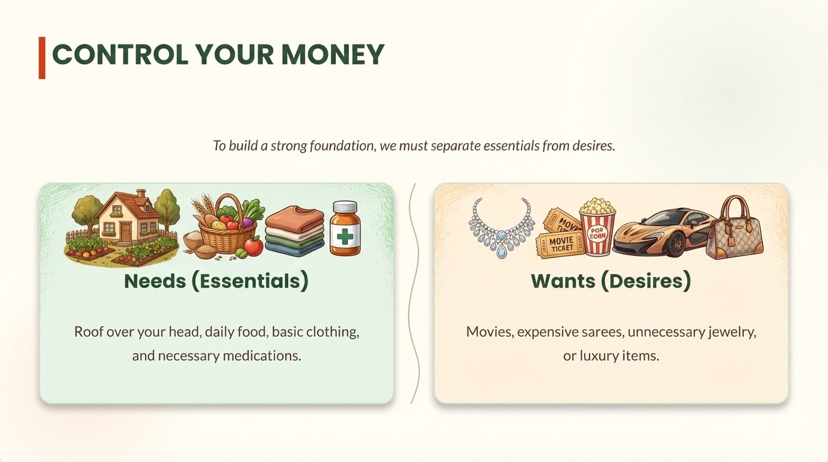

Slide 4

PAY YOURSELF FIRST
The Golden Rule:
Do not save what is left after spending; spend what is left after saving. Even tiny amounts saved regularly build a family safety net.

Slide 5
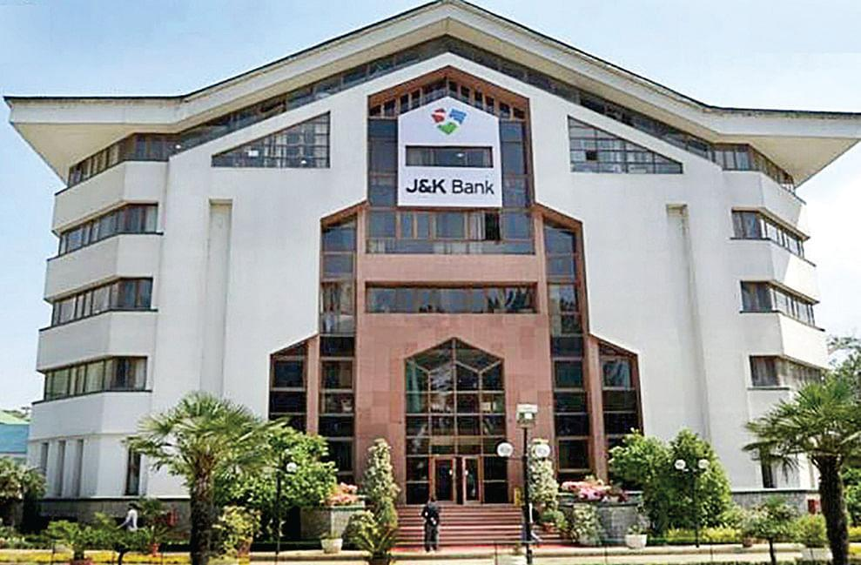



A SAFE HOME FOR YOUR HARD WORK
Through the Pradhan Mantri Jan-Dhan Yojana (PMJDY), every adult has the right to a basic banking account.
Interest on deposit & safe storage.
Accidental & Life insurance cover.
Universal access to credit and pension.

Slide 6




SMART BORROWING
Good Debt
Bad Debt
Investment that produces wealth. Example: PMMY loan for business or child's education.
Borrowing for things that lose value or to cover daily consumption expenses.

Slide 7



GROW YOUR FUTURE: SMART GOALS
Short-Term
Medium-Term
Long-Term
Buying a motorbike or tool in 10 months.
Saving for significant home repairs or expansion.
Saving for a secure and dignified retirement.
Goal: Rs. 50,000

Slide 8
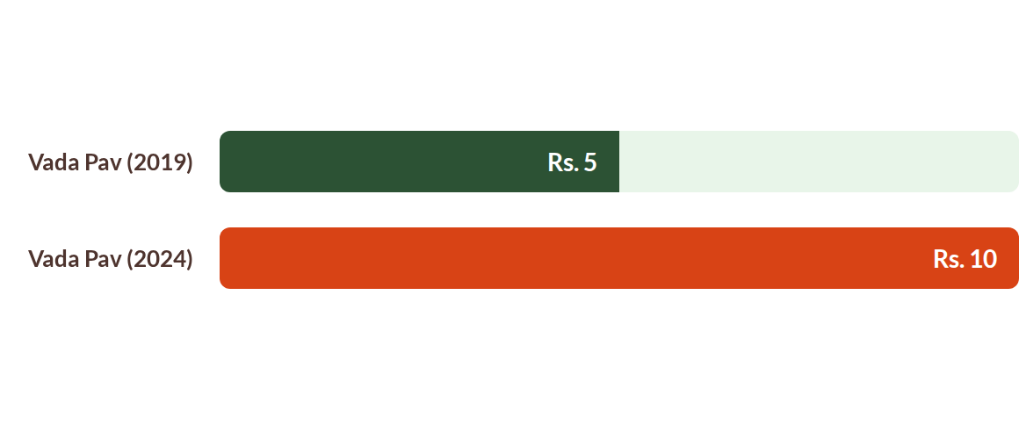
DEFEATING THE INVISIBLE THIEF
Inflation: Why your money must grow faster than rising prices.
The food didn't get bigger; your money just became less powerful.

Slide 9




WHERE TO GROW YOUR MONEY SAFELY
Post Office Savings
SIP (Mutual Funds)
Government-backed schemes with a sovereign guarantee—extremely safe.
Small, fixed amounts monthly into Mutual Funds to build wealth over time.

Slide 10






SAVINGS & PENSION SCHEMES
Atal Pension Yojana
Sukanya Samriddhi
Social Security (Ins.)
Guaranteed monthly pension (Rs. 1000-5000) for workers in the unorganized sector.
Special high-interest savings account for a girl child's education and marriage.
PMJJBY & PMSBY: Life and accidental insurance for less than Rs. 500/year.

Slide 11



PROTECT YOUR HARVEST
Ponzi Schemes: Promises of overnight doubling or high returns for recruiting. They always collapse.
Lottery Scams: Requests for a "tax fee" to claim a prize. Real contests never charge fees to collect winnings.
Card Fraud: Sharing PINs or OTPs allows criminals to empty your account. Protect your secret codes.
THE GOLDEN RULE: Never share your PIN or OTP with anyone!

Slide 12
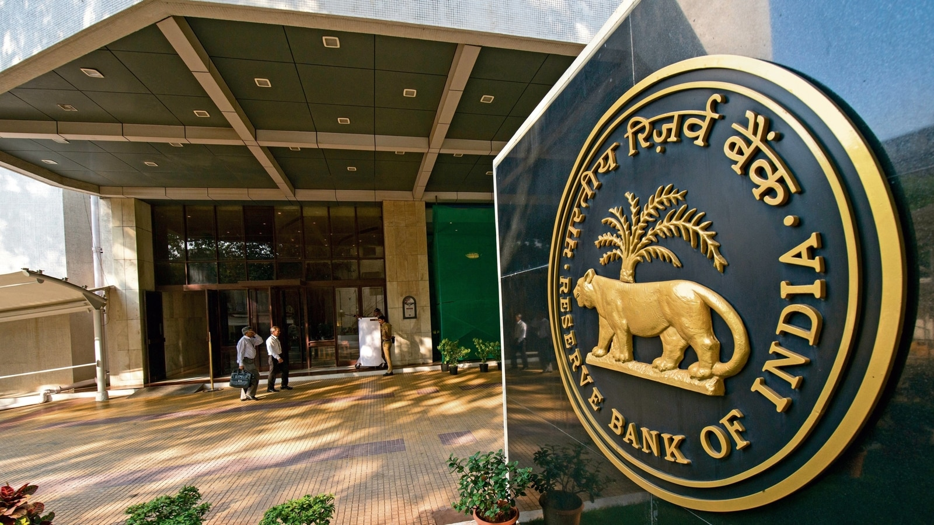



YOUR SUPPORT SYSTEM
You are not alone. Powerful Indian regulators protect your money and rights:
RBI: Protects your banking rights.
SEBI: Protects your investments.
IRDAI: Regulates your insurance.
PFRDA: Secures your pension funds.
These institutions exist to ensure fair play and hear your grievances if you are wronged.

Slide 13
An Empowered Community
Uplifting ourselves and our entire Self-Help Group.
Let's make our hard work work for us!

