Slide 1





Swachhata App, Swachh City Platform & SBM Engineer App

Slide 2
SWACHHATA APP
Used by the Citizens/Residents of the ULB to Post a Complaint especially related to Sanitation

Slide 3
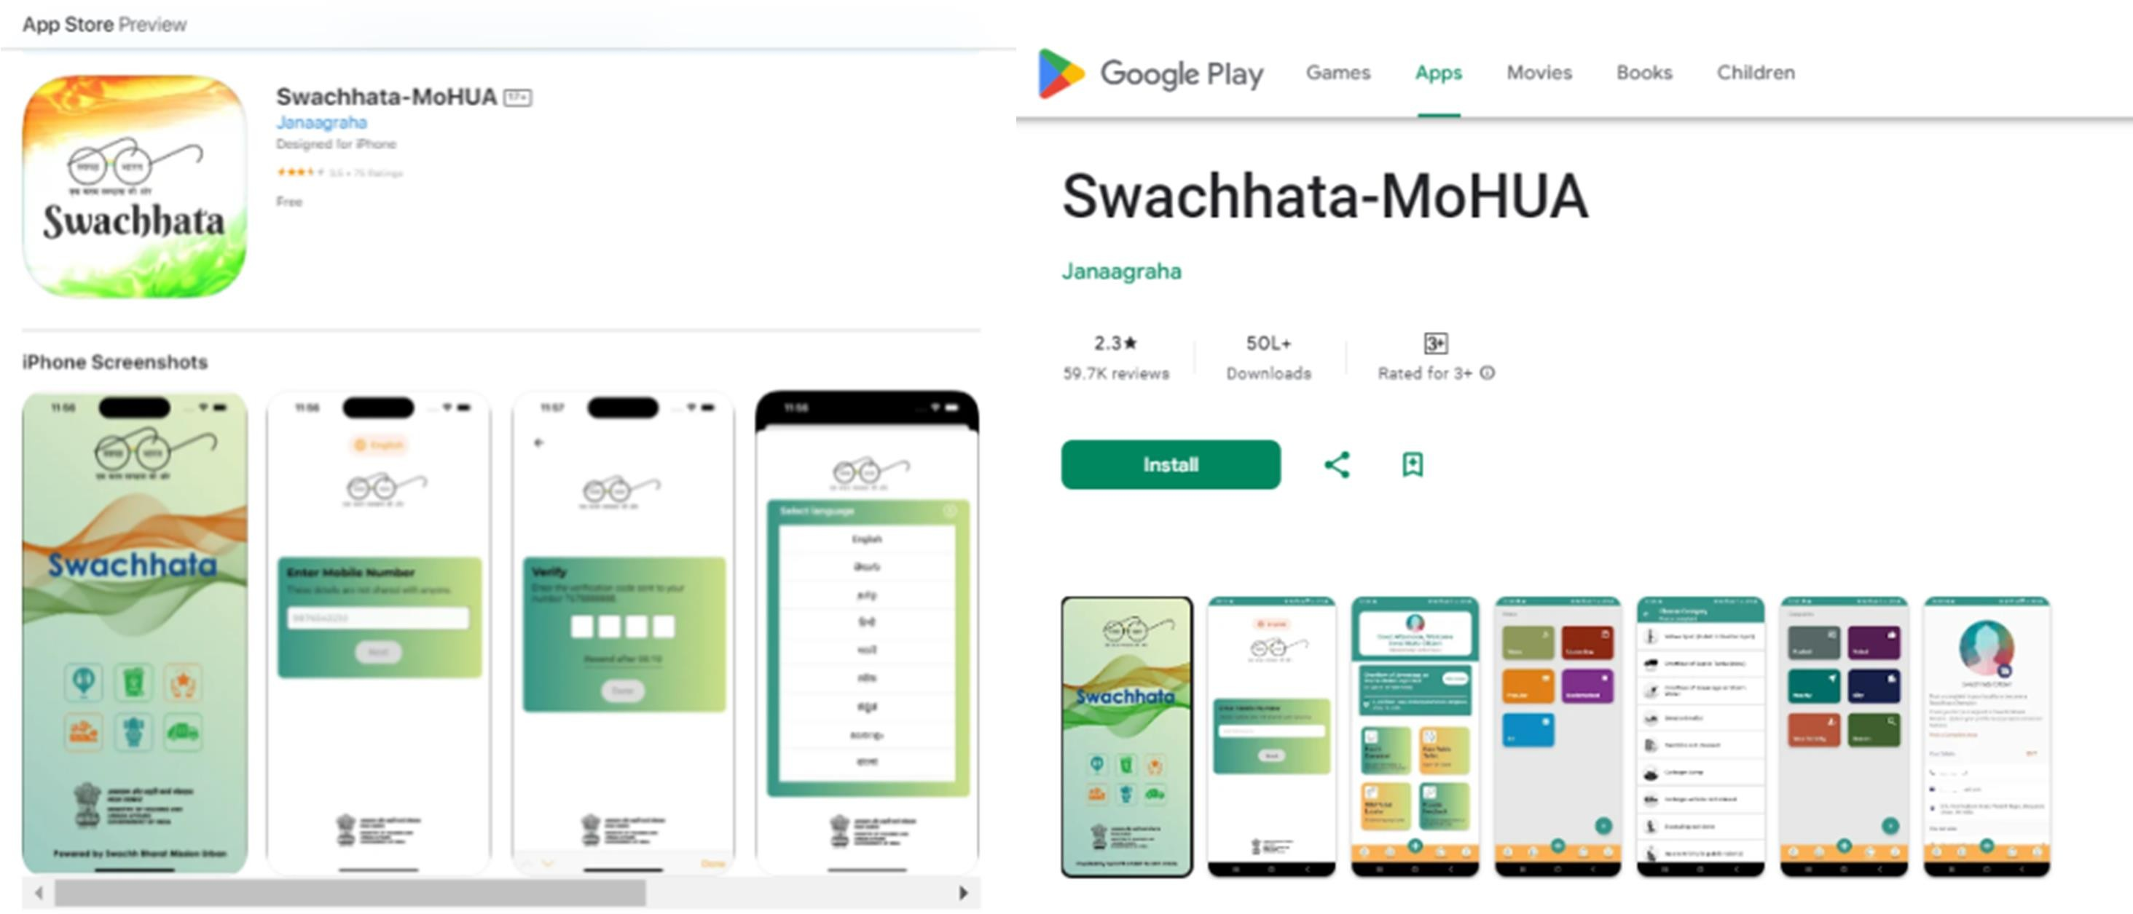
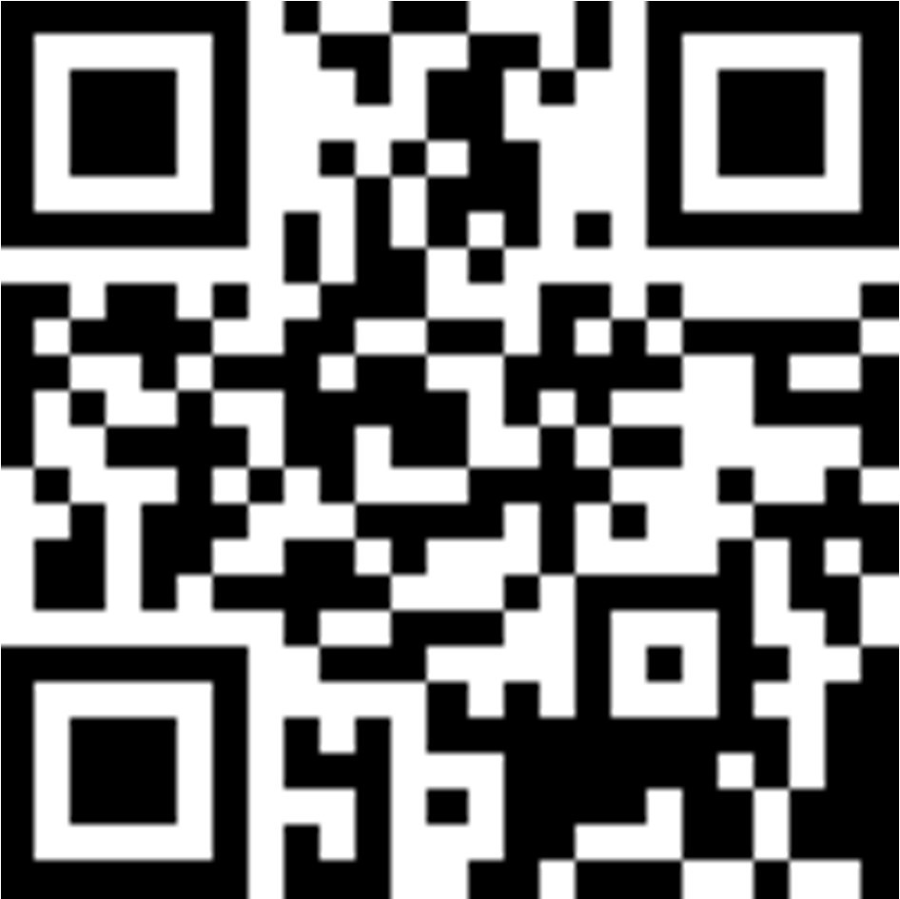

Citizen/Resident of the ULB to Download Swachhata App

Slide 4
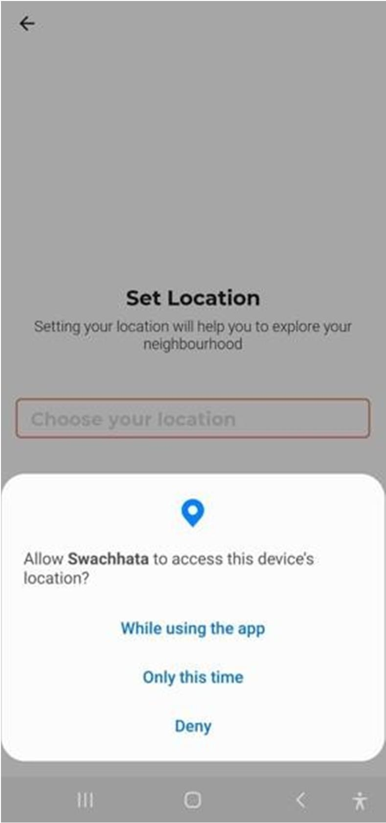
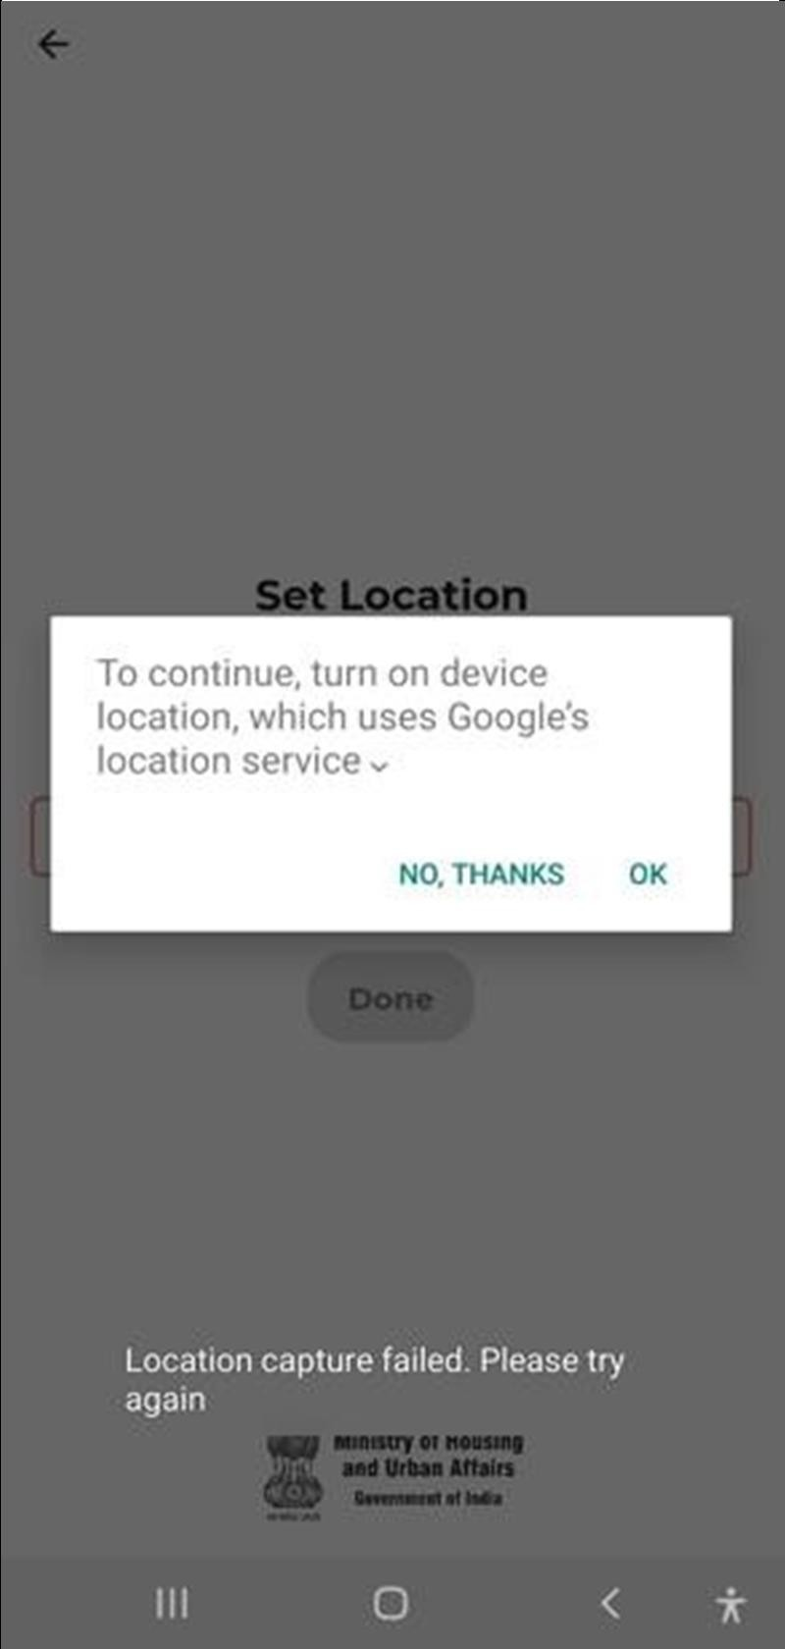
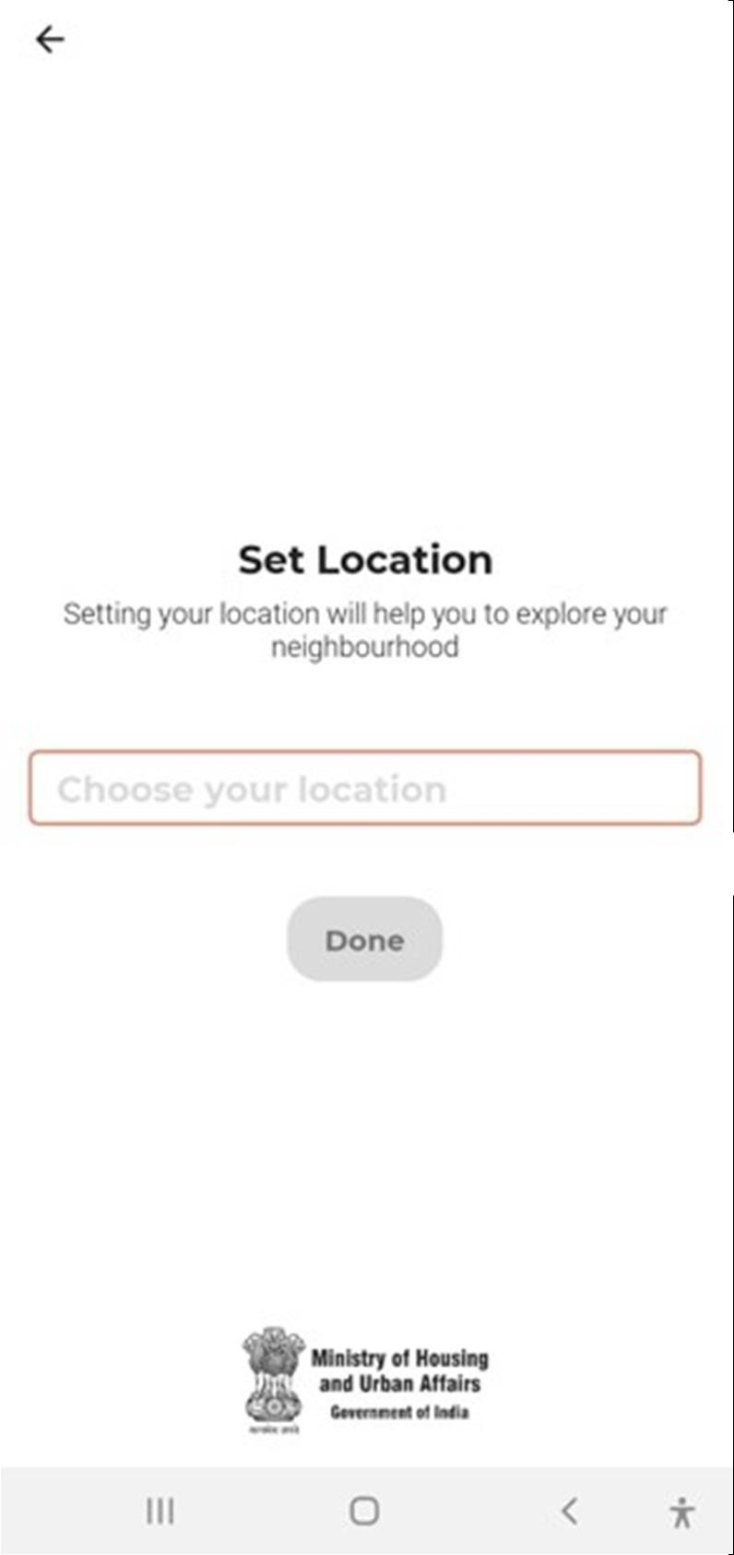
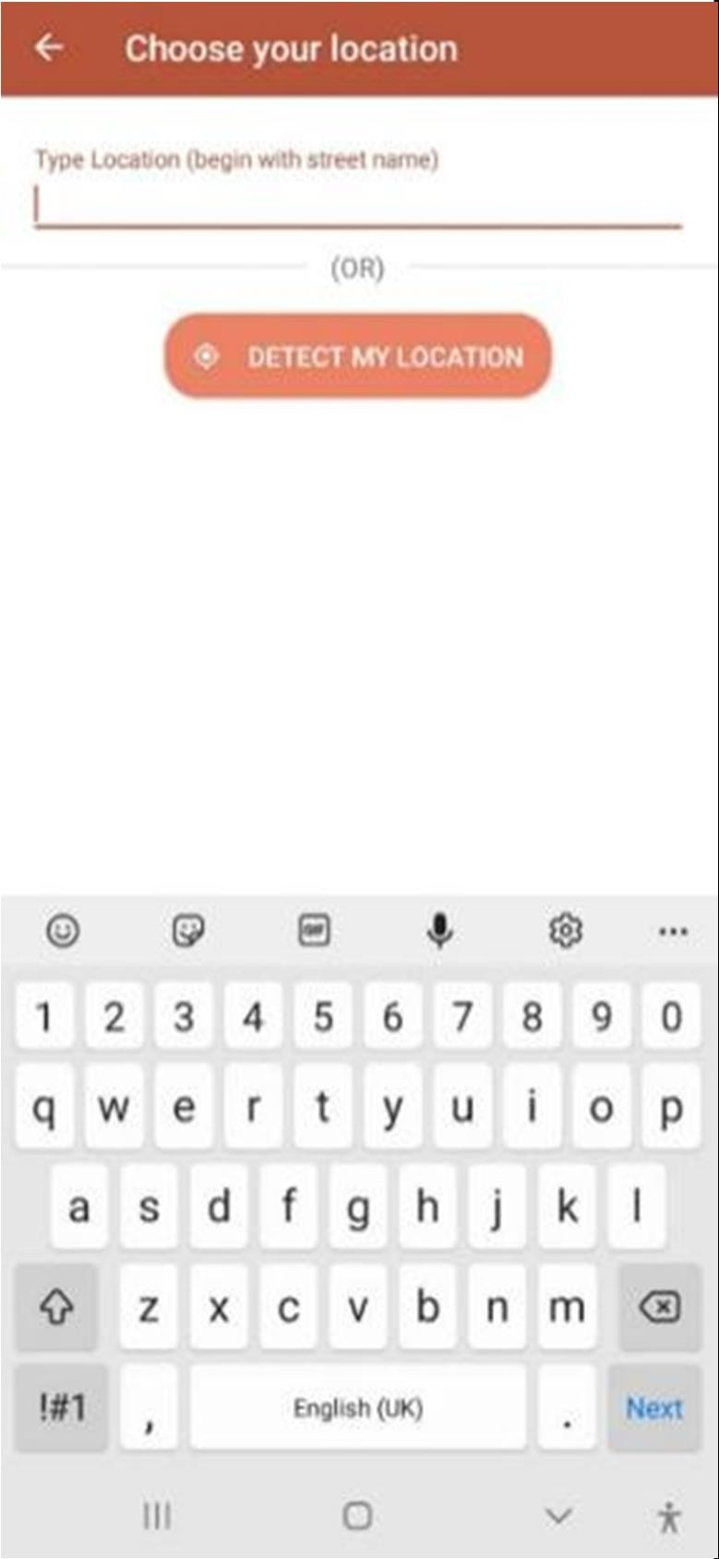
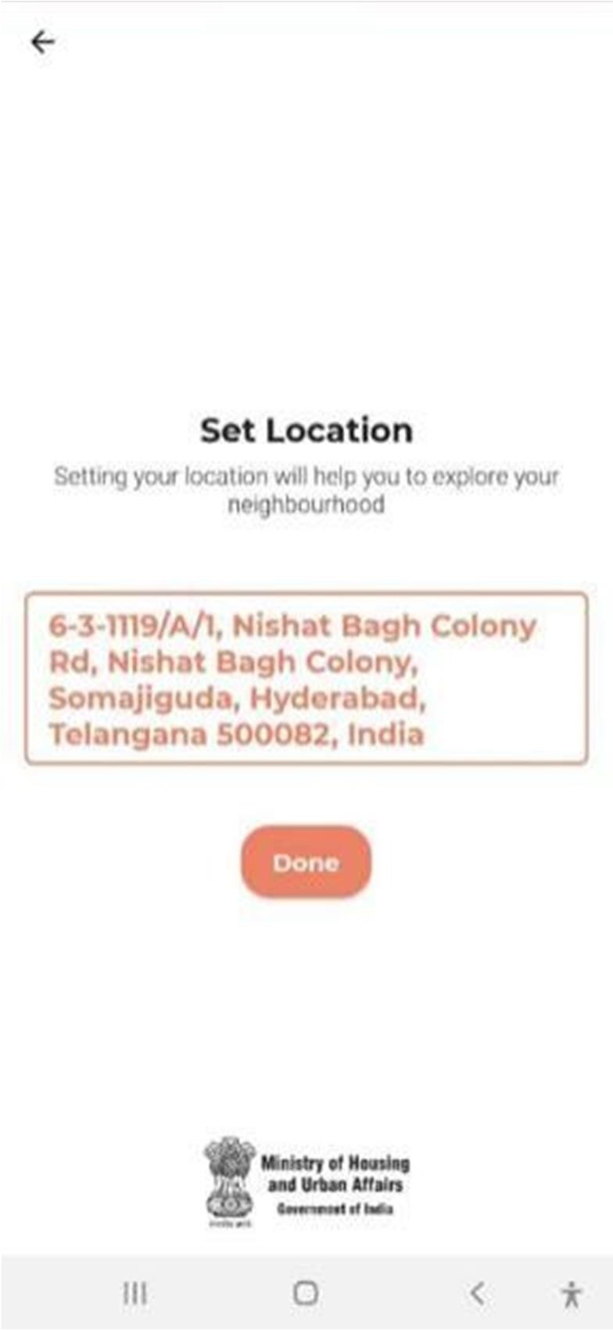
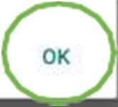
Citizen/Resident to Set Location on Swachhata App

Slide 5
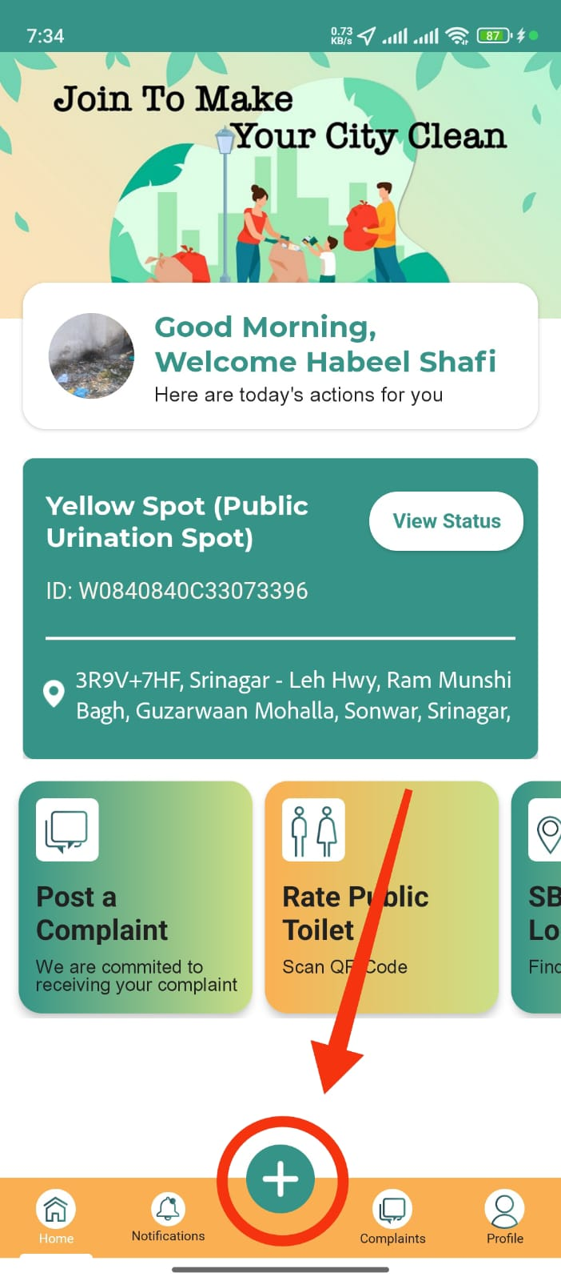
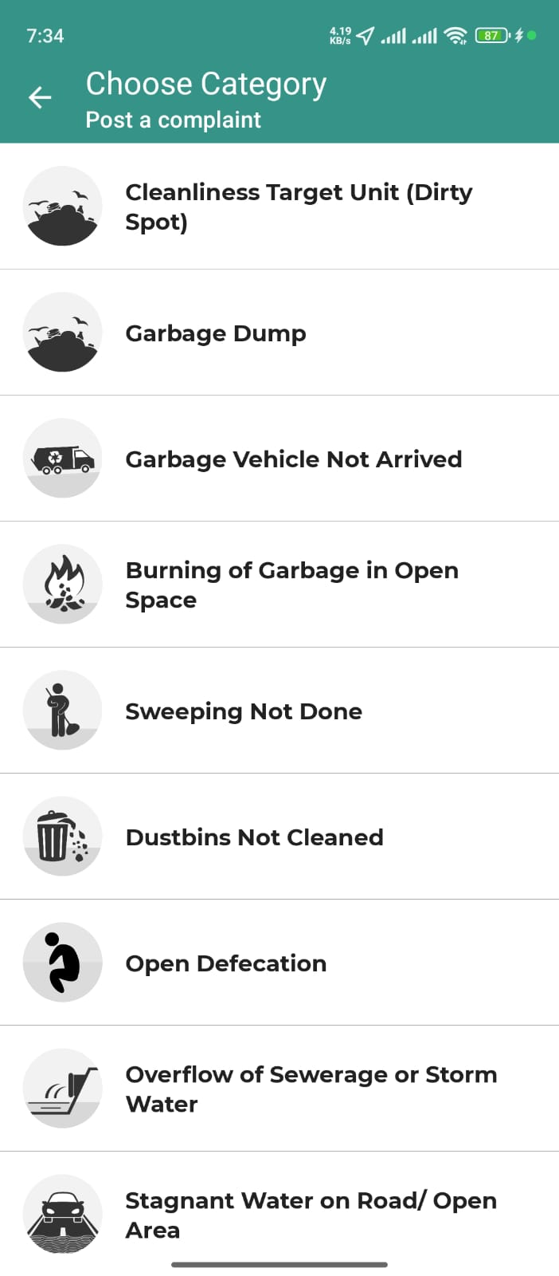
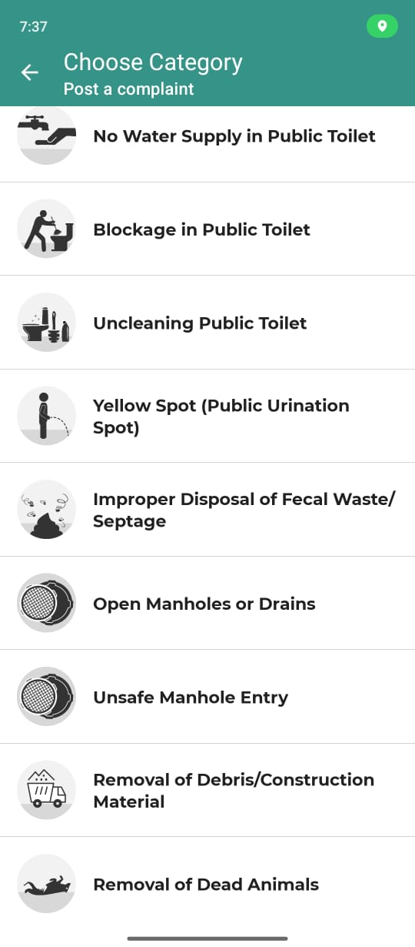
Post a Complaint and Choosing Category

Slide 6
S.No | Swachhata Complaint Category | Service Level Agreement
1 | Removal of Dead Animals | 48 hours
2 | Dustbin not cleaned | 12 hours
3 | Garbage dump | 12 hours
4 | Garbage vehicle not arrived | 12 hours
5 | Sweeping not done | 12 hours
6 | No Electricity in Public Toilet | 12 hours
7 | No Water Supply in Public Toilet | 12 hours
8 | Blocked Public Toilet | 12 hours
9 | Uncleaned Public Toilet | 12 hours
10 | Open Manholes or Drains | 12 hours

Slide 7
S.No | Swachhata Complaint Category | Service Level Agreement
11 | Overflow of Sewerage or Storm Water | 12 hours
12 | Stagnant Water on Road/ Open area | 12 hours
13 | Improper Disposal of Fecal waste/Septage | 12 hours
14 | Removal of Debris/Construction Material | 12 hours
15 | Burning of garbage in open space | 12 hours
16 | Open Defecation | 12 hours
17 | Overflow of Septic Tanks | 12 hours
18 | Yellow Spot (public urination spot) | 1 week
19 | Cleanliness Target Unit (Dirty Spot) | -
20 | Unsafe Manhole Entry | -

Slide 8
SWACHH CITY PORTAL
Used by the ULB Admin to Assign & Monitor the Received Complaint till Resolution.

Slide 9
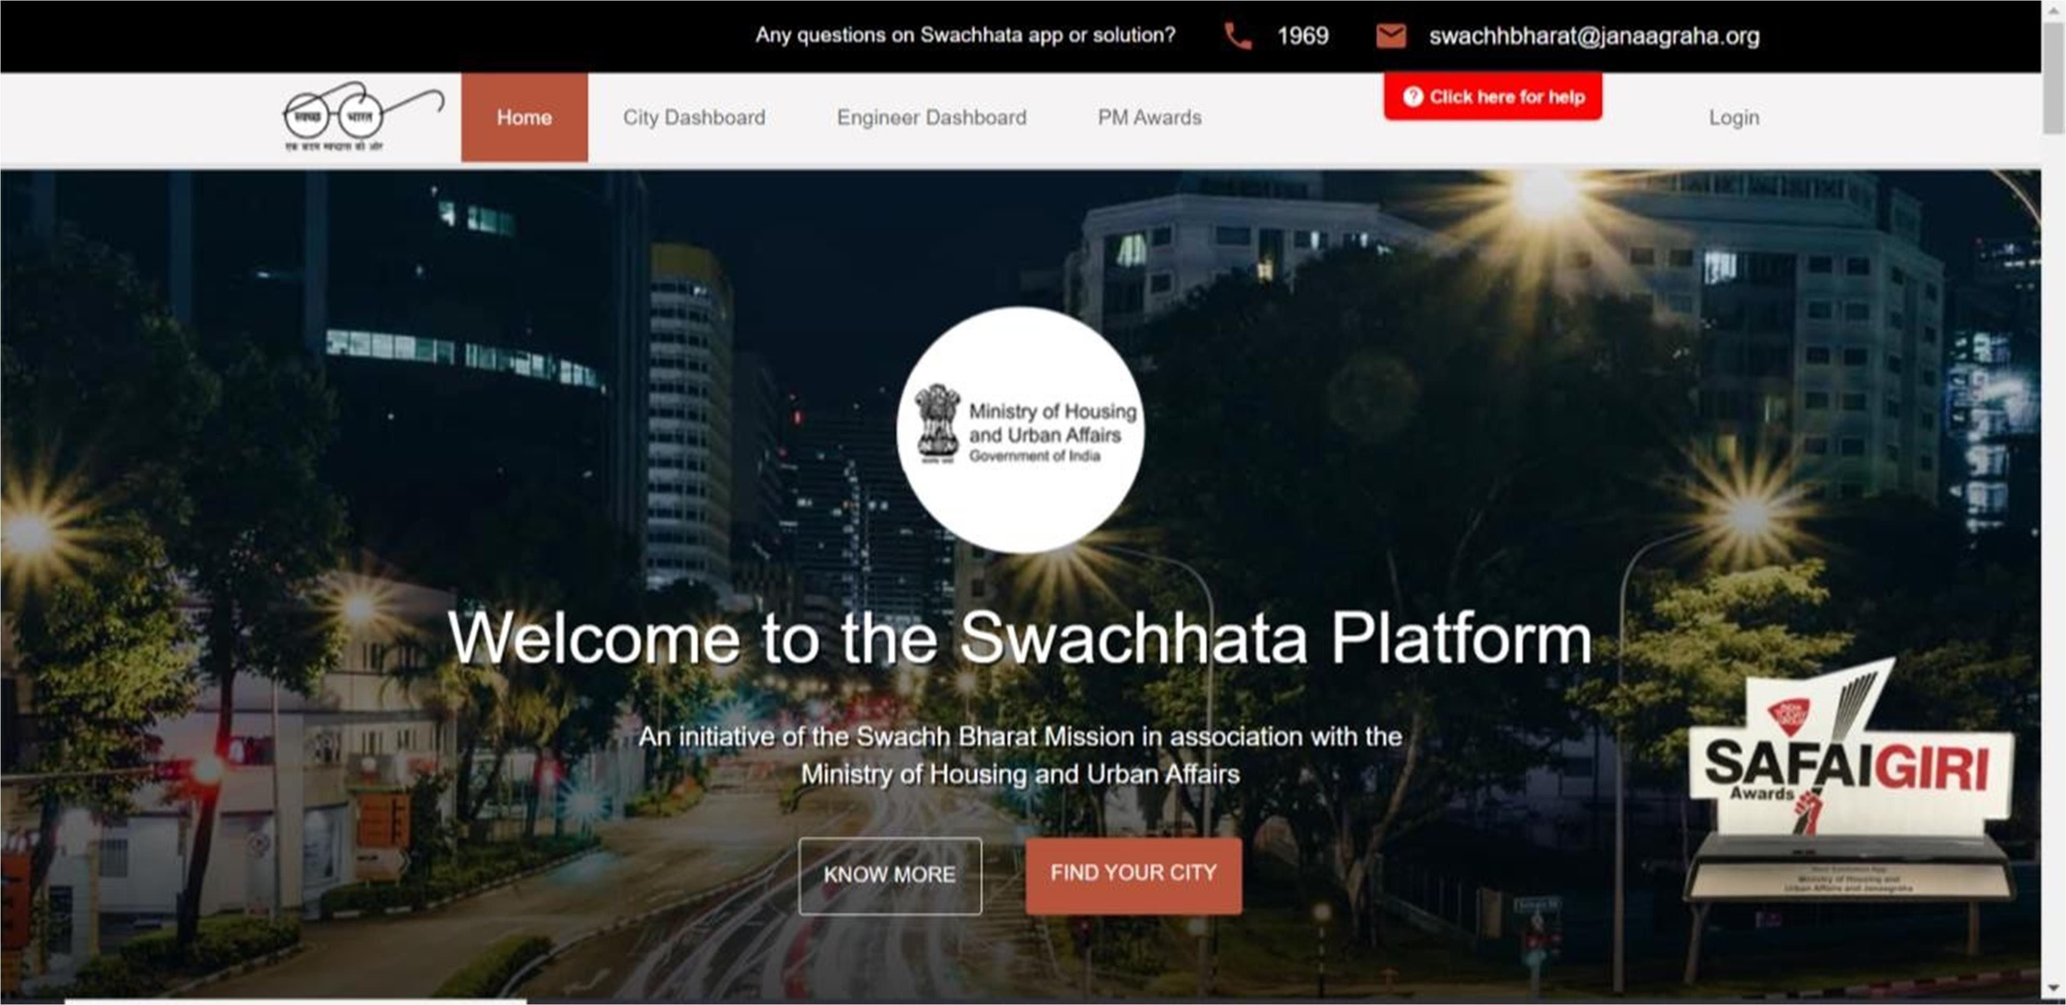
Swachh City Homepage

Slide 10
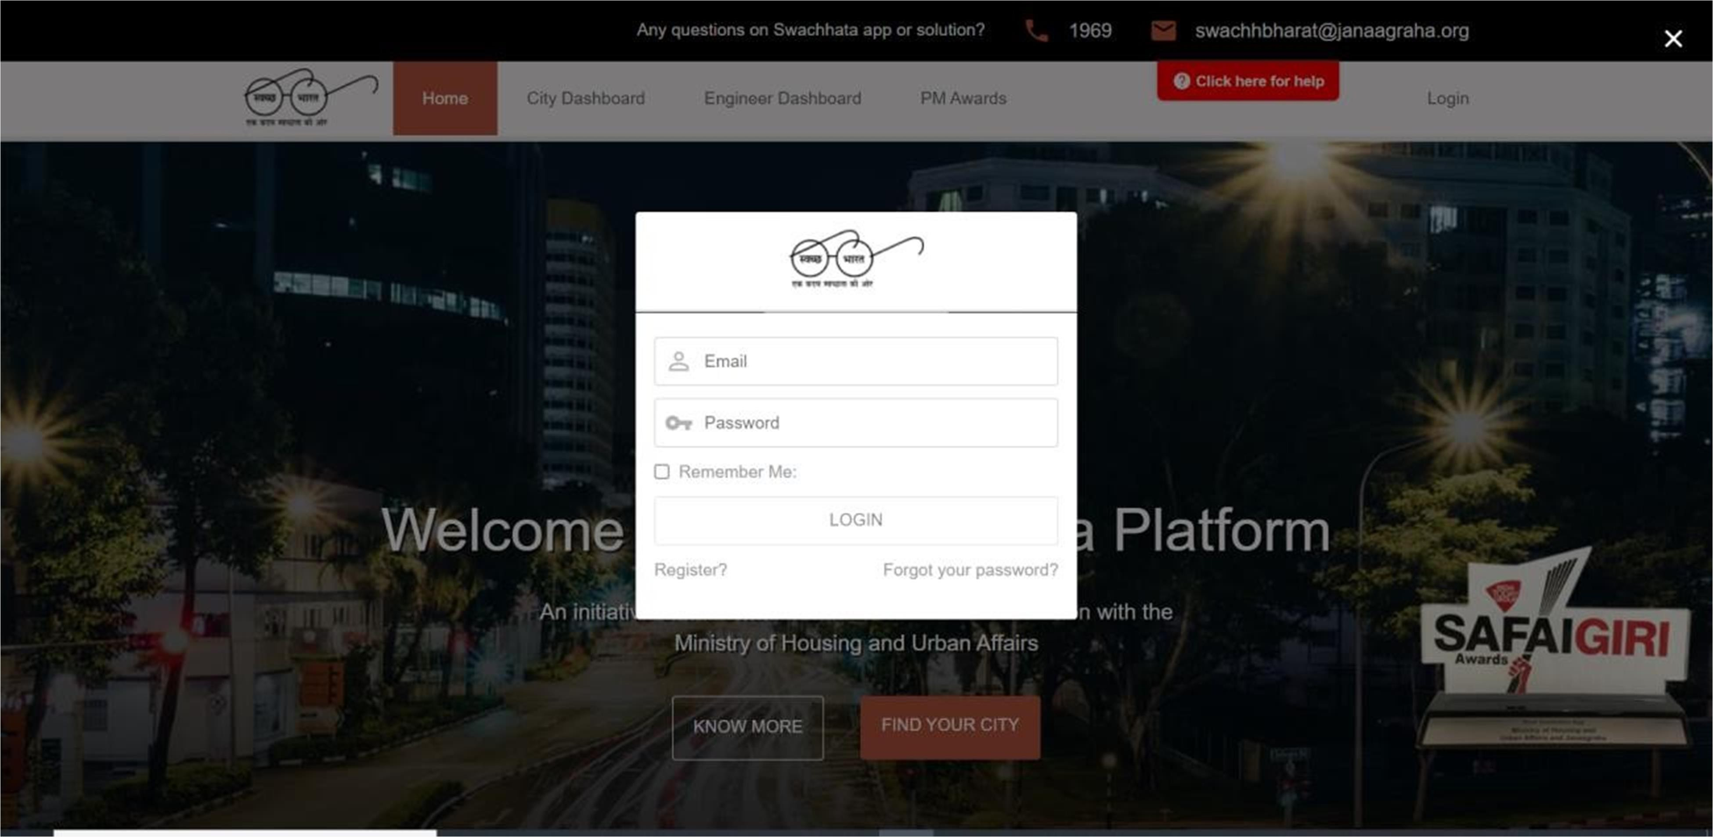
Swachh City Login Page

Slide 11
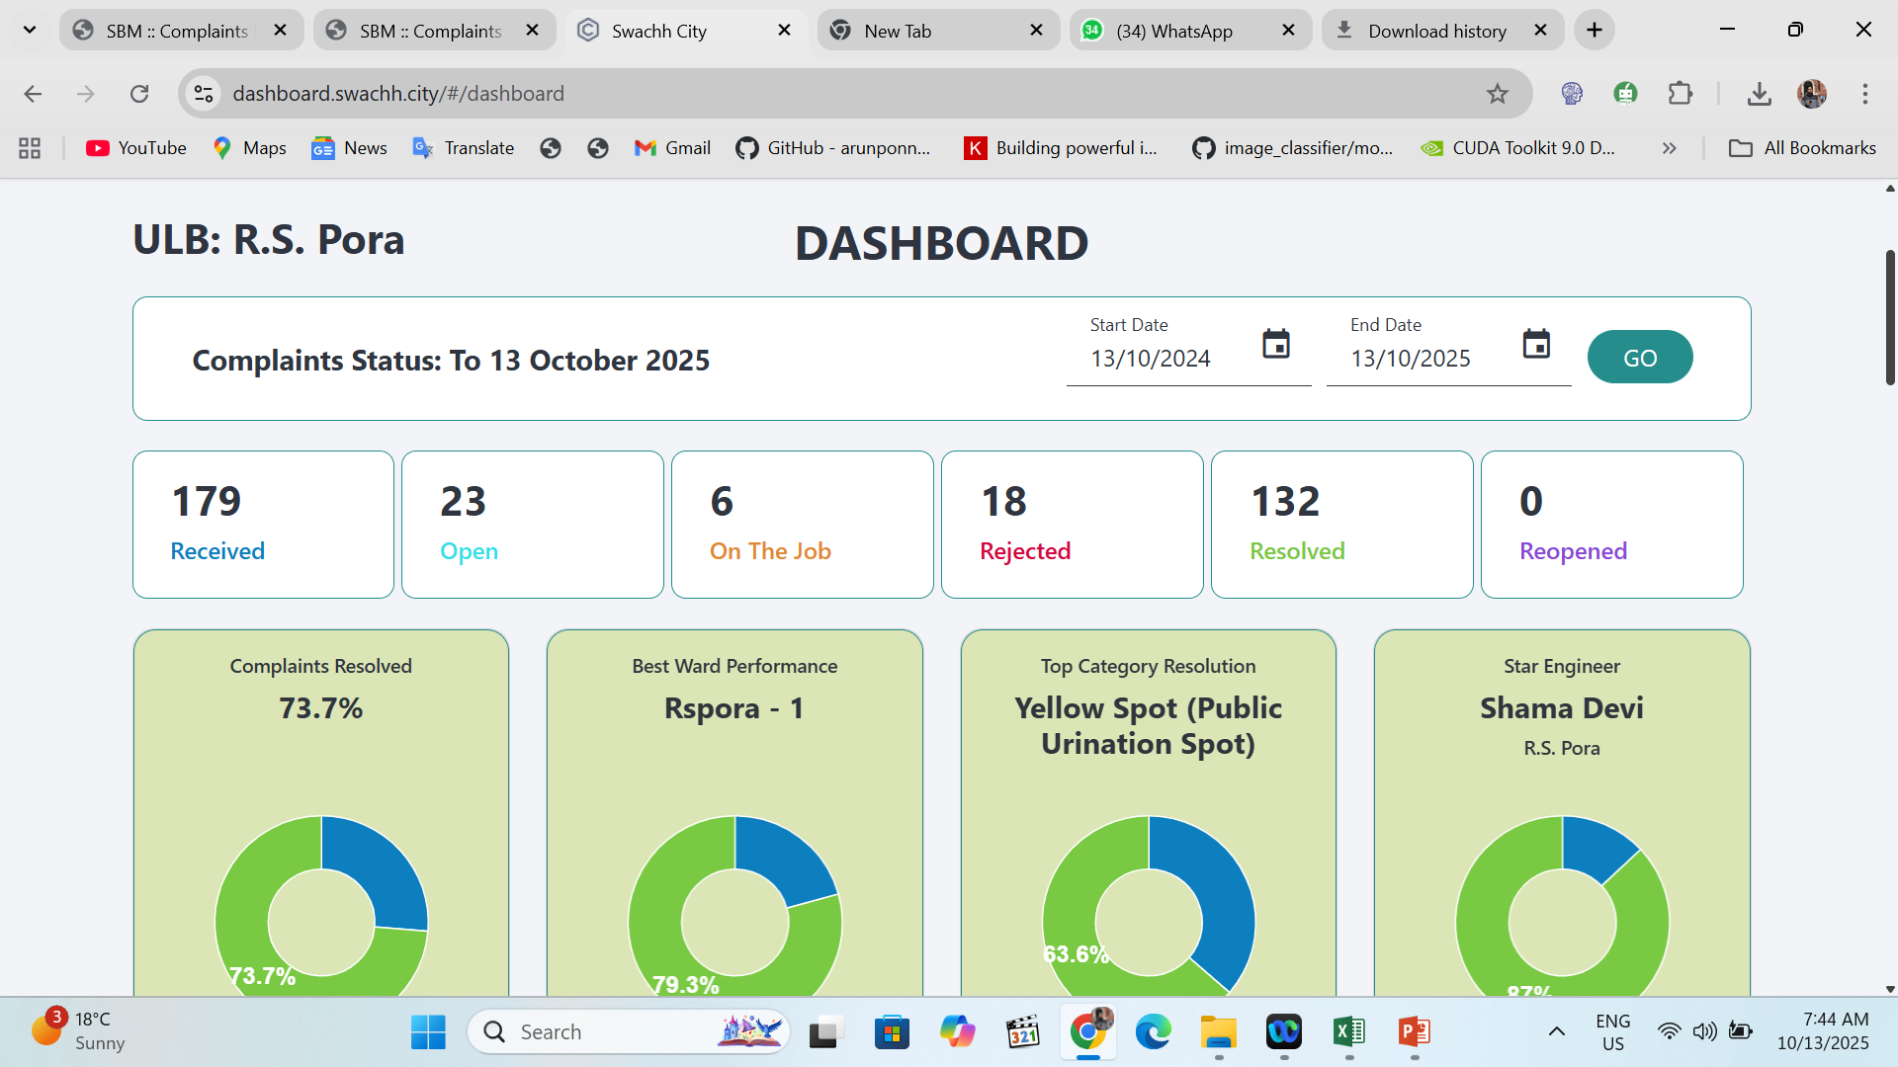
Swachh City Dashboard

Slide 12
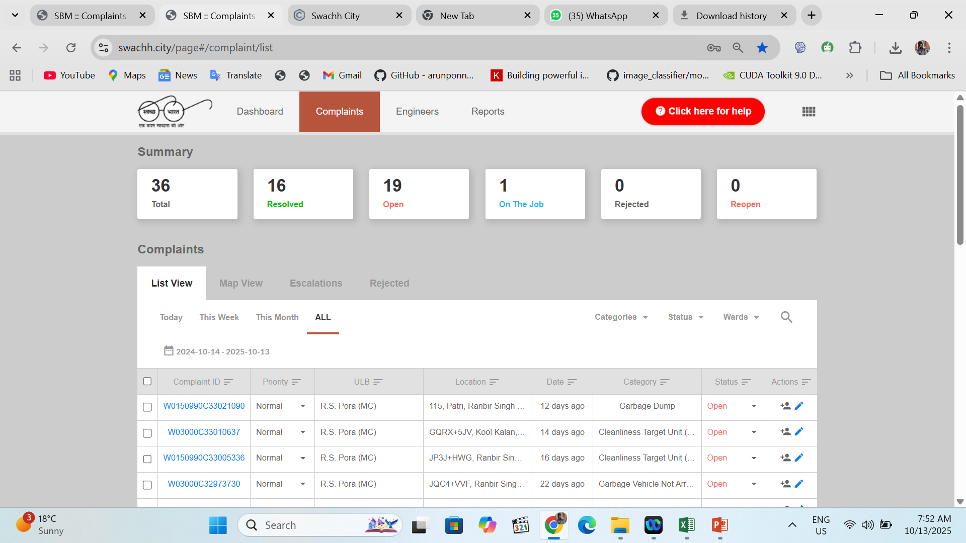
Swachh City Complaints Tab

Slide 13
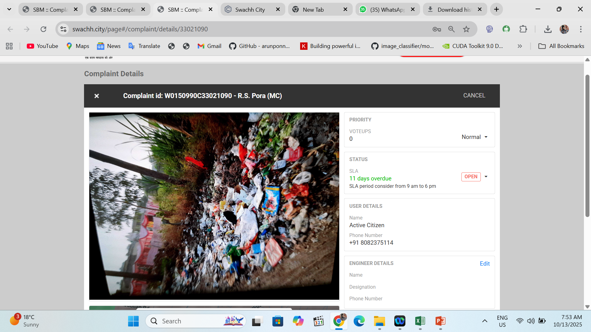
View the Complaint by the ULB Admin

Slide 14
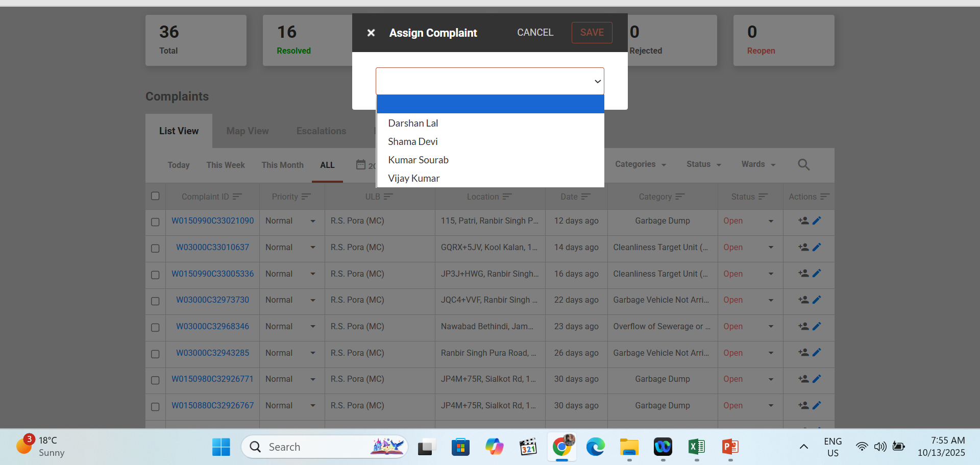
Assigning the Complaint by the ULB Admin

Slide 15
SBM ENGINEER APP
Used by the Sanitation Staff/DEOs etc of the ULB to Resolve the Complaint

Slide 16
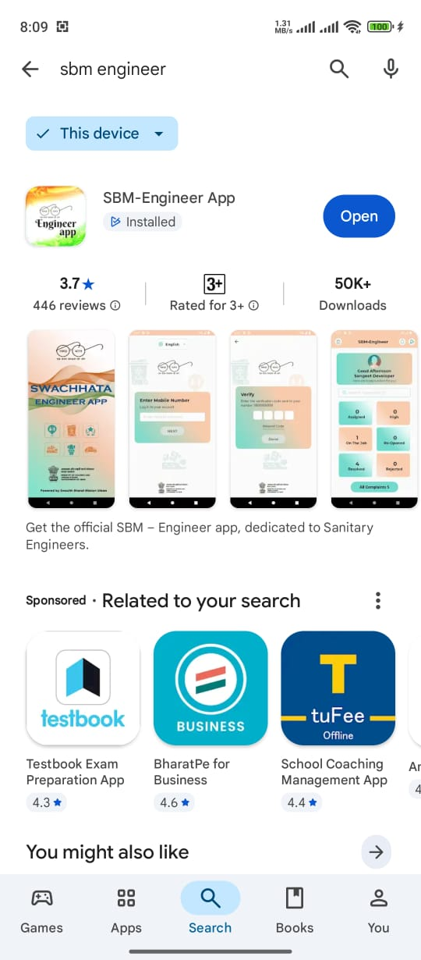
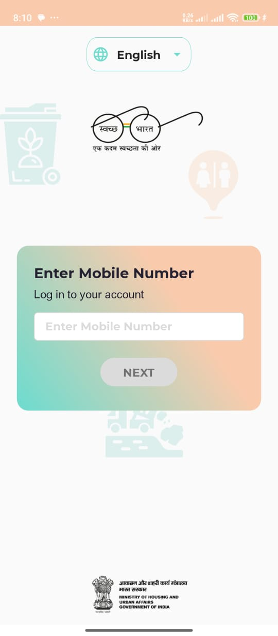
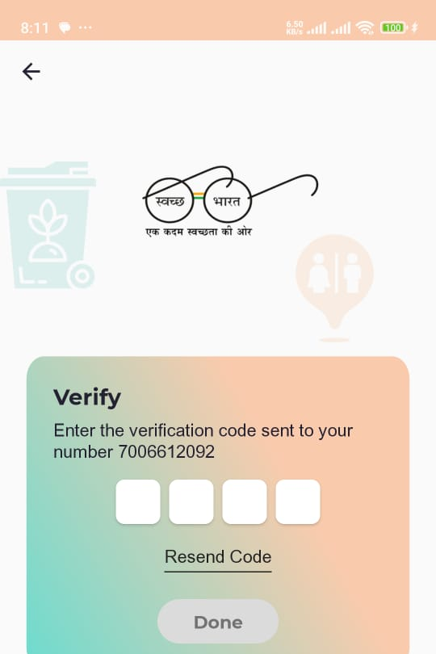
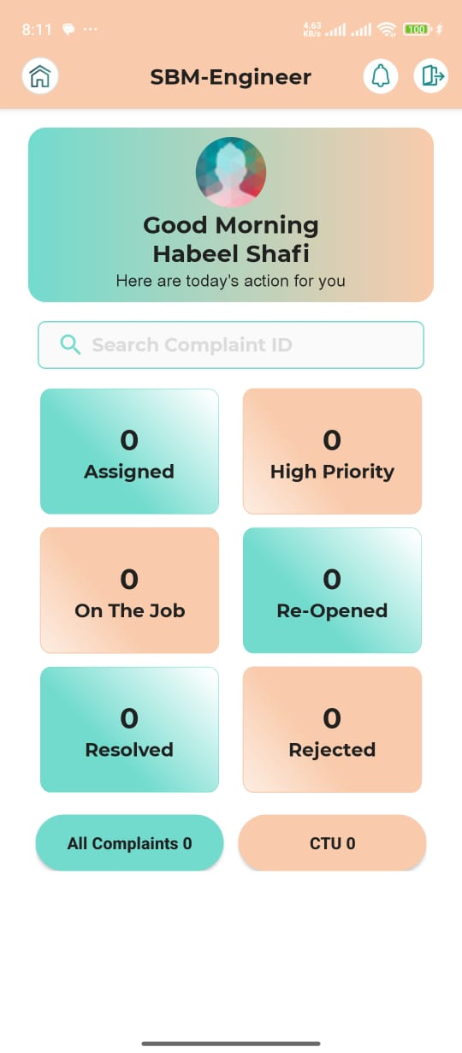
Concerned Staff of the ULB to Download SBM Engineer App and Login Using OTP

Slide 17
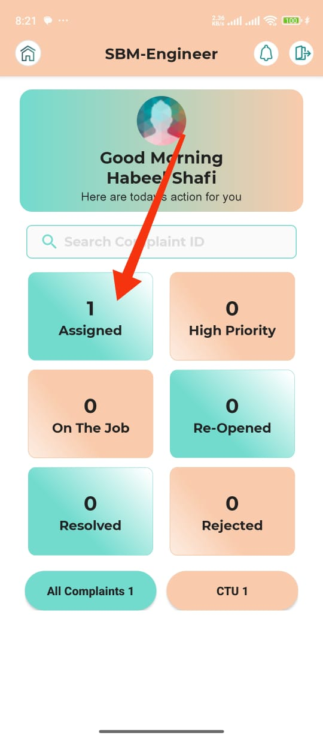
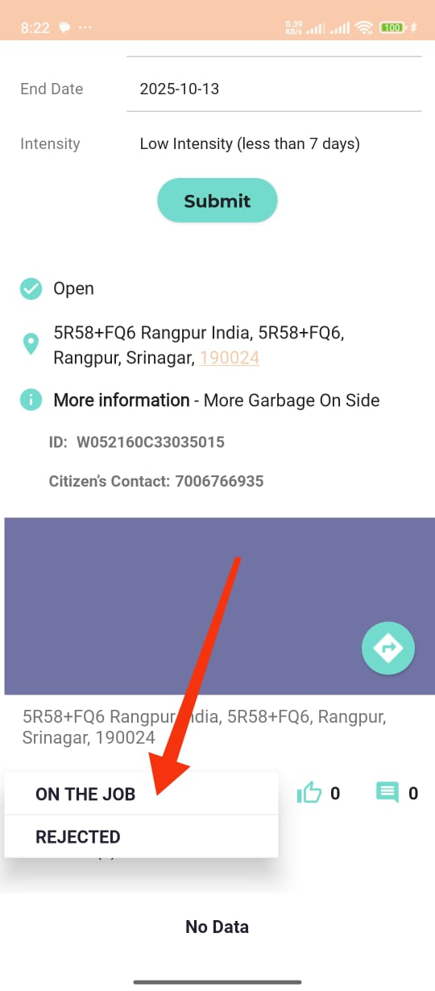
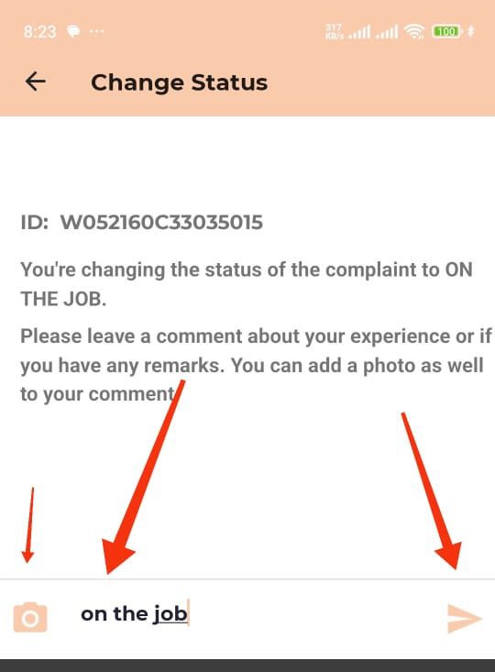
Assigned complaint will pop-up in the Assigned tab open and put the complaint on the job

Slide 18
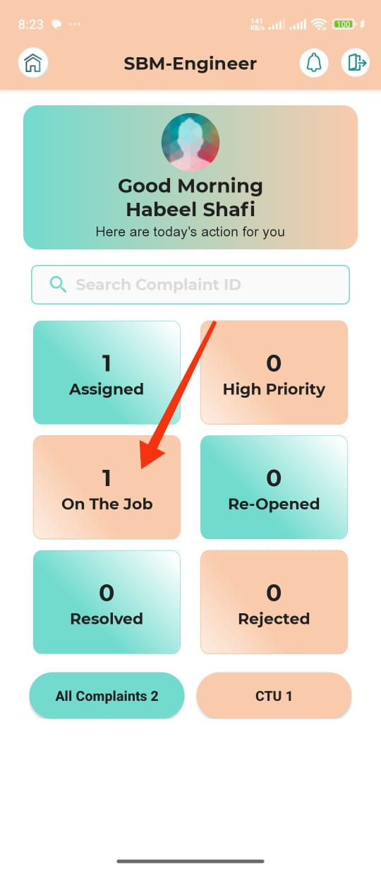
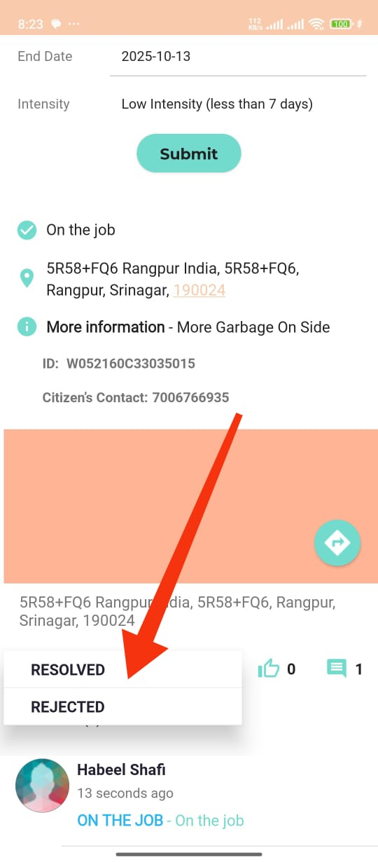
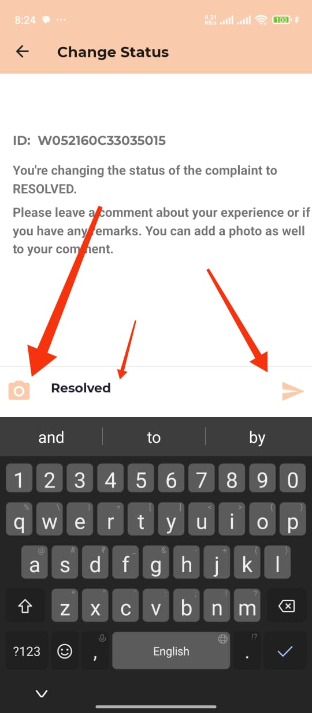
Resolve the complaint which was put on “On The Job”

Slide 19
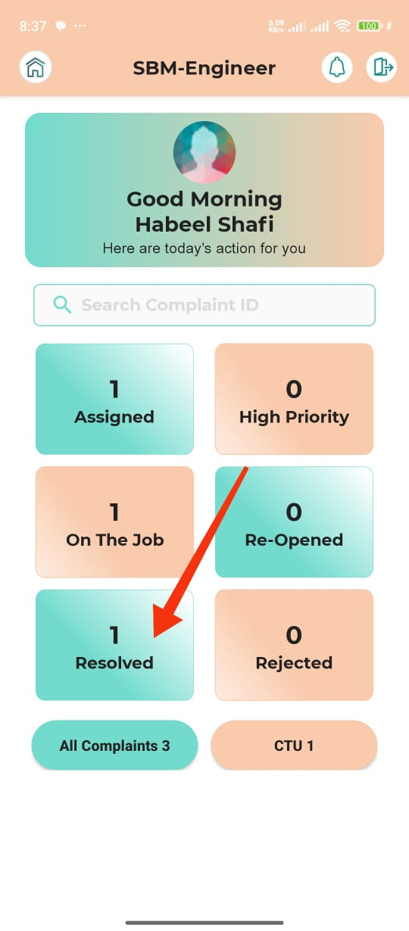
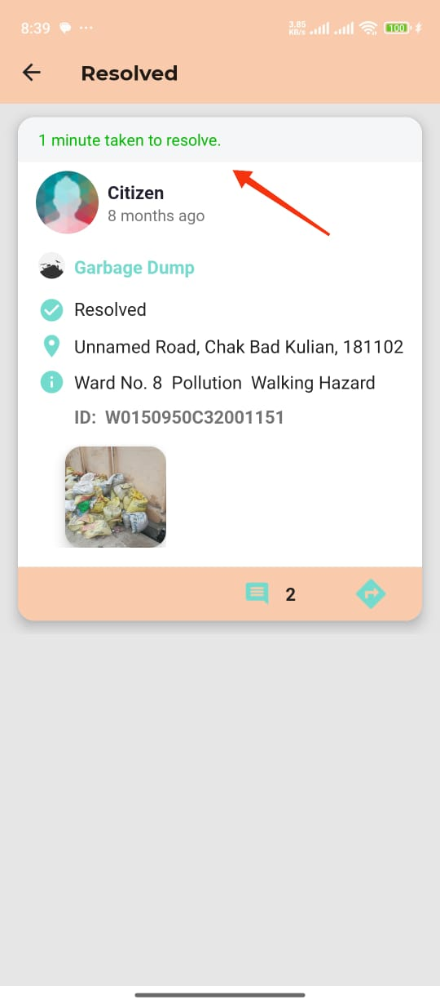
After Resolving the Complaint it will pop up in the Resolved Tab.

Slide 20
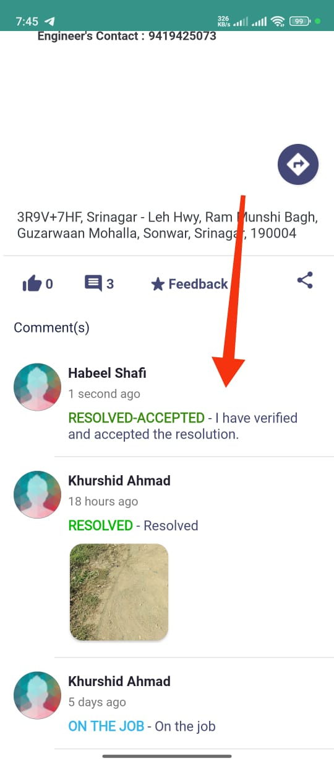
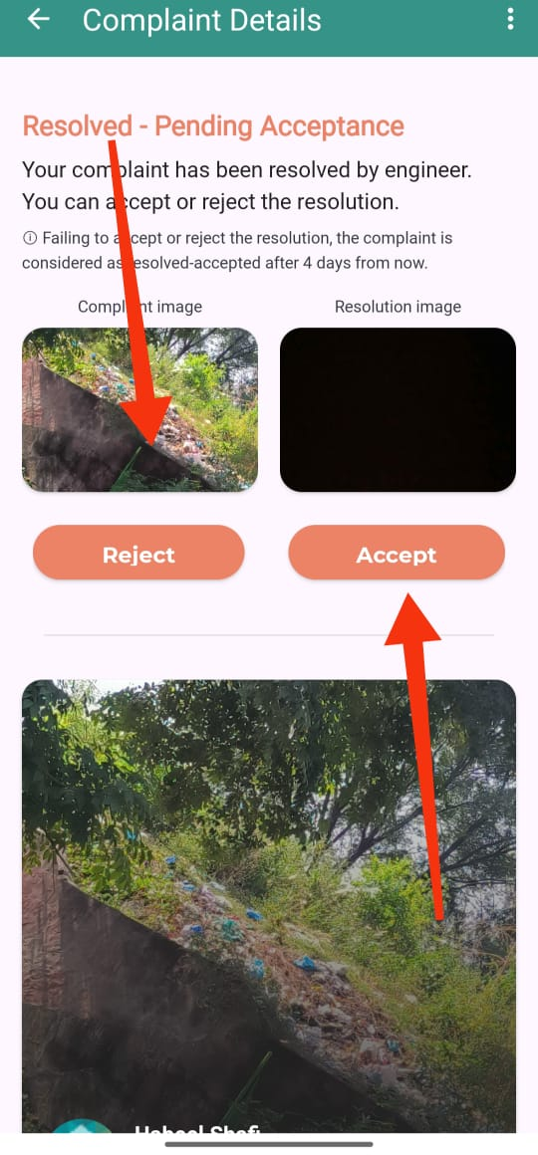
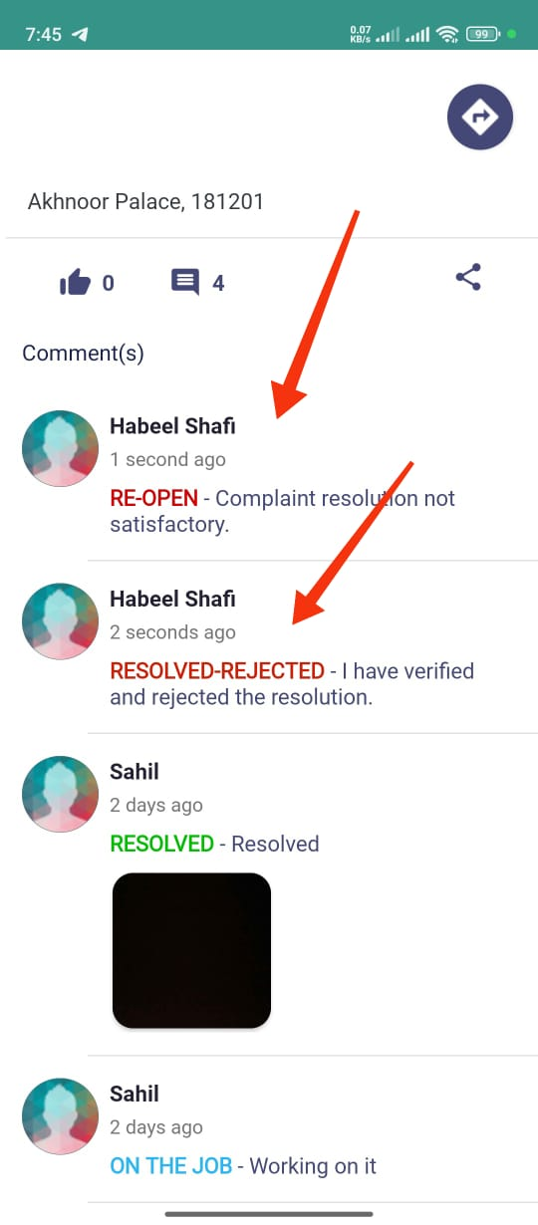
The Citizen/User/Resident of the ULB will Accept or Reject the Complaint, if Rejected by the user then it will appear in the Re-opened Tab of SBM Engineer App.

Slide 21
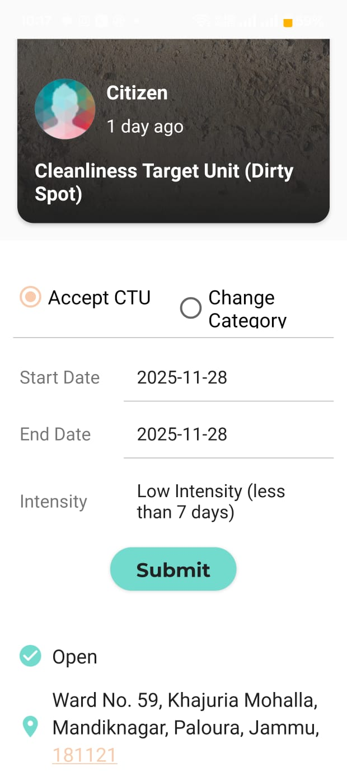
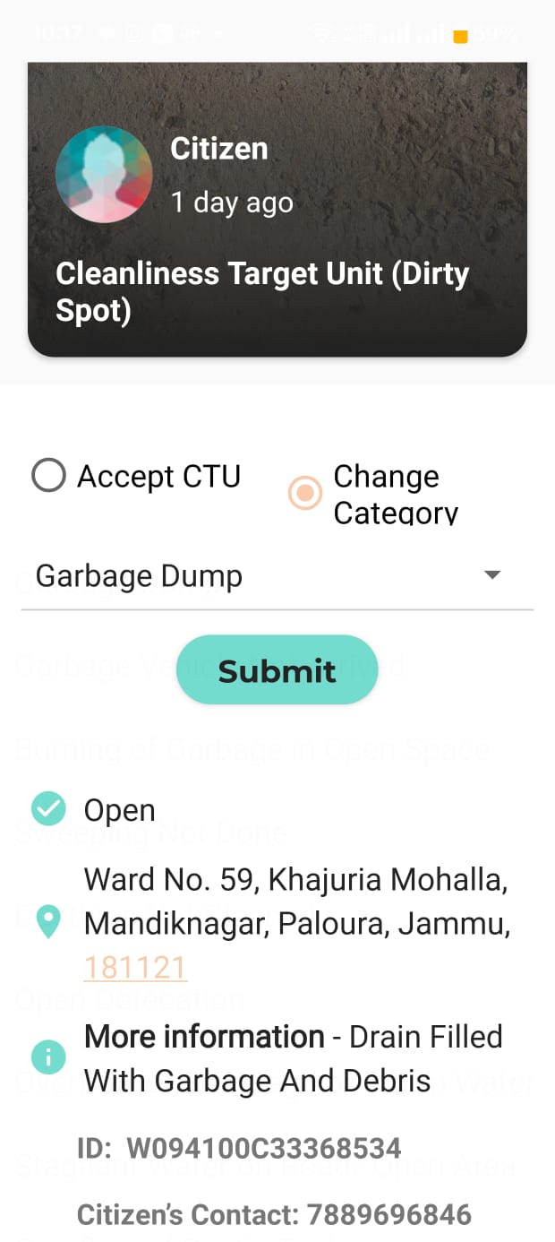
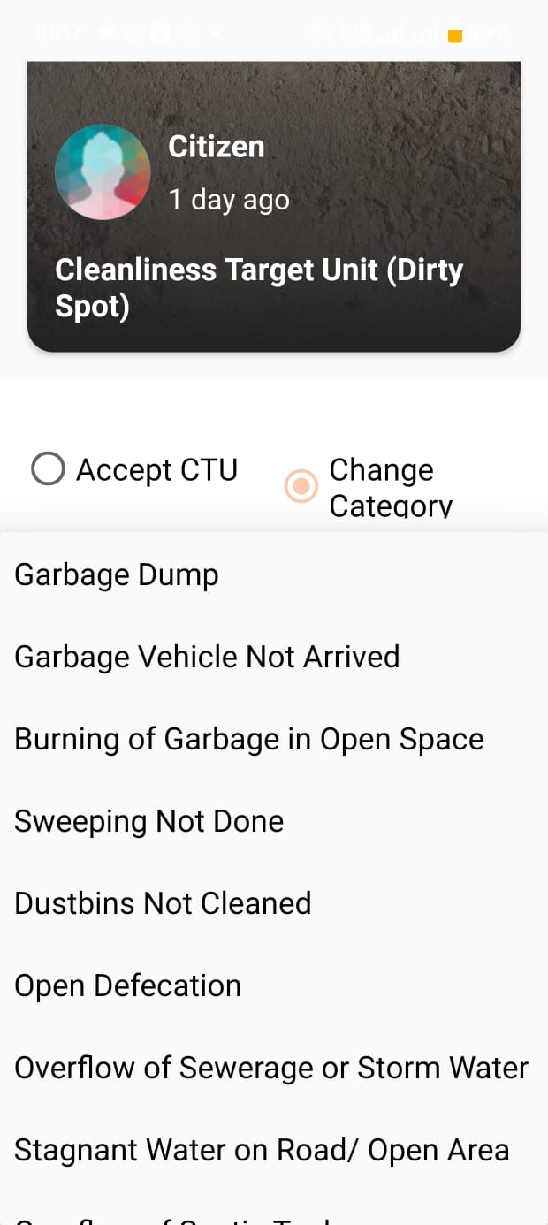
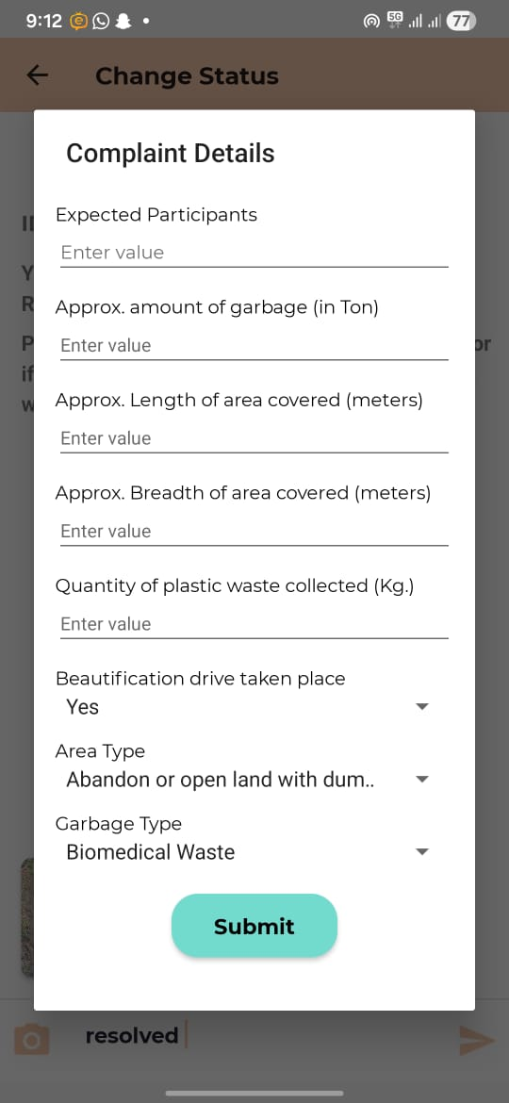
Special Case - CTUs

Slide 22
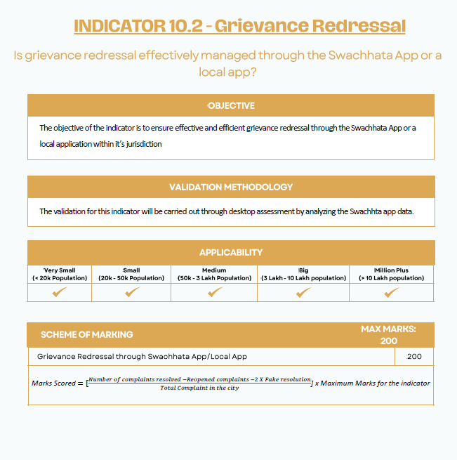
In Swachh Survekshan it contains 200 Marks
To achieve GFC Rating – Resolution of 50% of received complaints within SLA is Mandatory

Slide 23



Thank You

