Slide 1
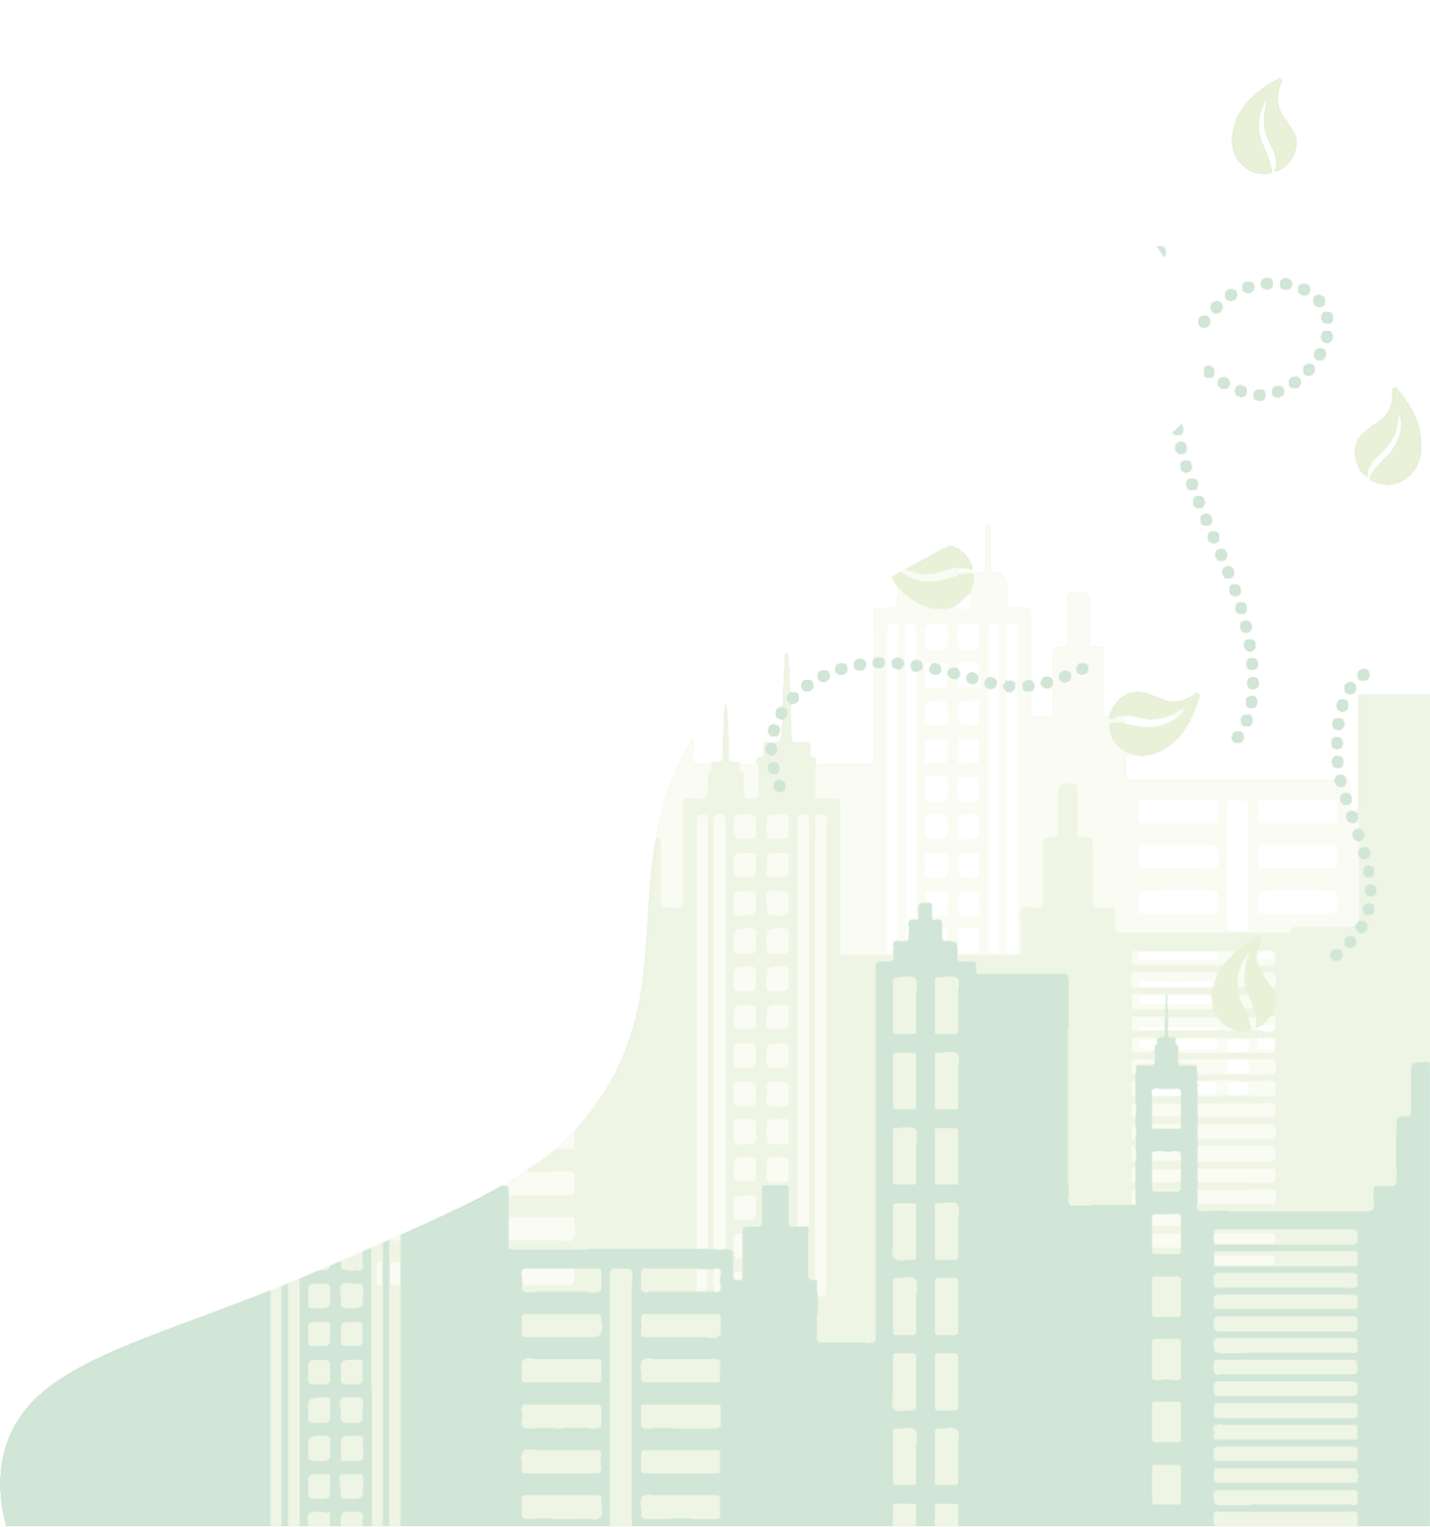


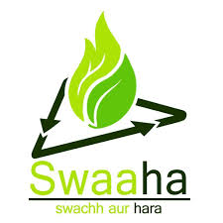
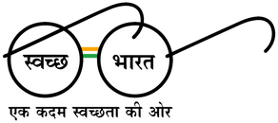

Capacity Building Session on
Segregation of Waste at Source, Door to Door Collection of Waste, Ban on Single Use Plastics and Use & Implementation of RRR Centers
“Har Kachre ka Bin Apna, Kachra Mukt Shehar Apna!"

Slide 2
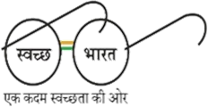
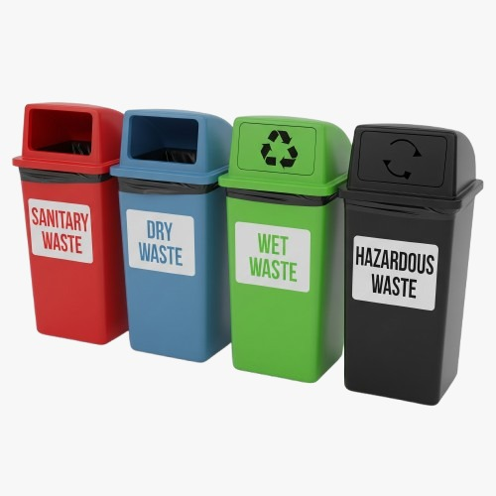
What is Source Segregation?
Source segregation is the process of separating different types of waste at the point where waste is generated — typically at homes, offices, schools or businesses — before it is collected for disposal or recycling.
This is the most important and effetive step for Solid Waste Management and a great service to the national program called Swachh Bharat Mission 2.0 Urban.

Slide 3
How it helps -
Source segregation helps in efficient waste management by separating waste at the source.
It promotes recycling and composting by keeping materials uncontaminated.
It reduces environmental pollution and health risks from hazardous waste.
Segregation lowers the burden on landfills and conserves resources.
It encourages public responsibility and supports legal compliance in waste handling.

Slide 4
Why is Segregation of Waste important?
Soil and Water Pollution | Hazardous chemicals from mixed waste can leach into the soil and contaminate groundwater.
Air Pollution | Burning unsegregated waste releases toxic gases, contributing to air pollution and respiratory issues.
Harm to Wildlife | Animals may ingest or get entangled in improperly discarded waste, leading to injury or death.
Blocked Drainage Systems | Mixed waste can clog drains, causing waterlogging, flooding and the spread of diseases.
Ineffective Recycling and Composting | Contaminated waste makes it difficult to recycle or compost, increasing landfill burden.

Slide 5
Key Principles:
Source Segregation
Blue
Dry Waste
Green
Wet Waste
Red
Sanitary Waste
Black
Domestic Hazardous Waste

Slide 6
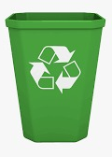
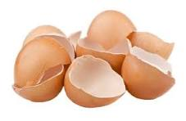
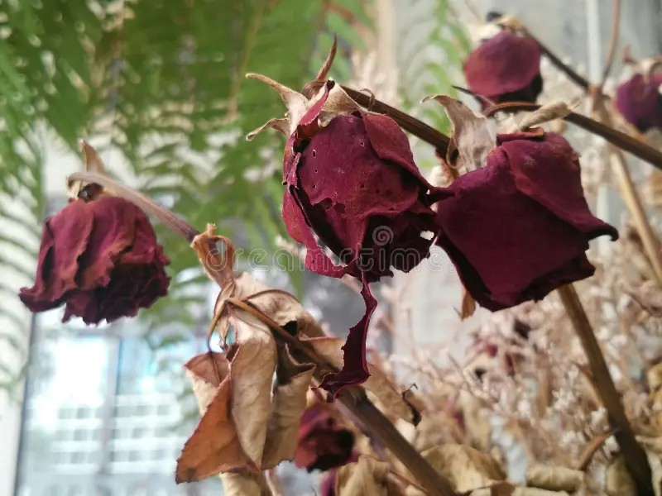
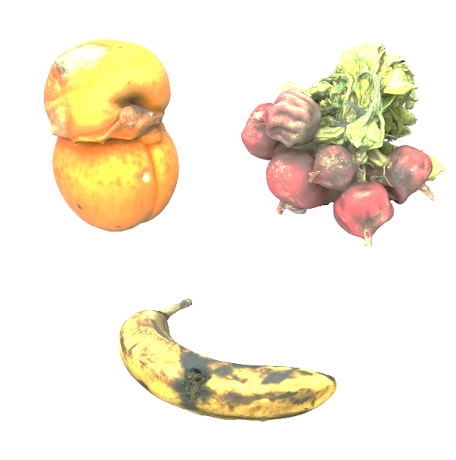
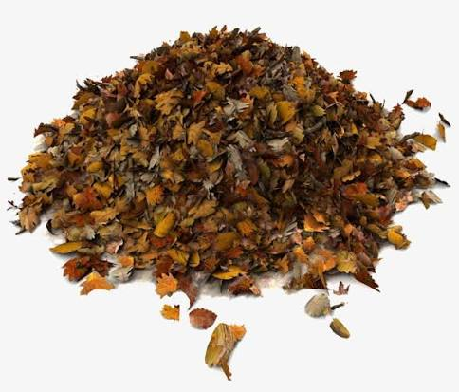
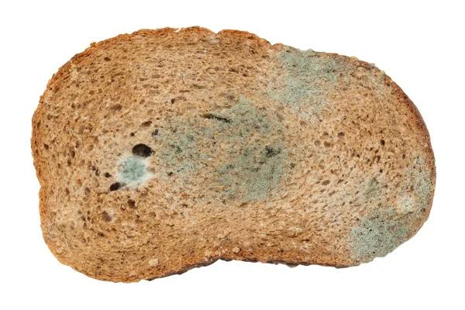
Categorization of Waste
 | Green Dustbin: This is for wet and biodegradable waste, such as food scraps, garden waste, and other organic materials that can be composted.

Slide 7
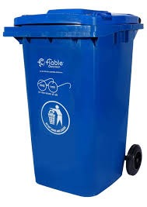
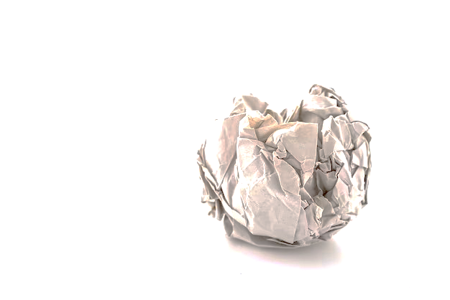
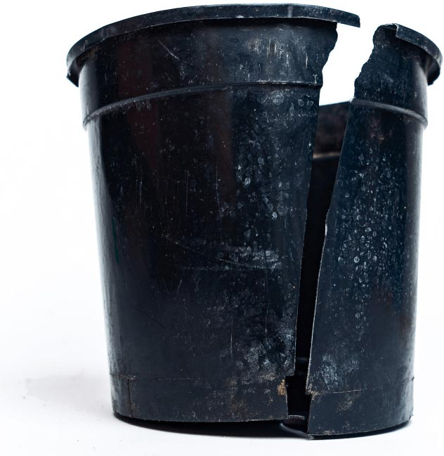
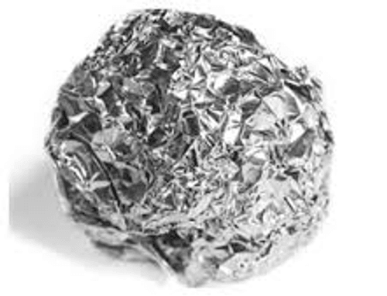
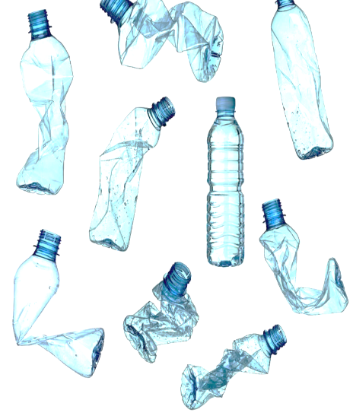
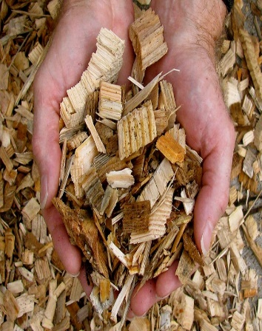
Categorization of Waste
 | Blue Dustbin: This is for dry, non-biodegradable waste that is recyclable, including paper, plastic and metal.

Slide 8
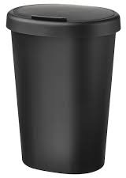
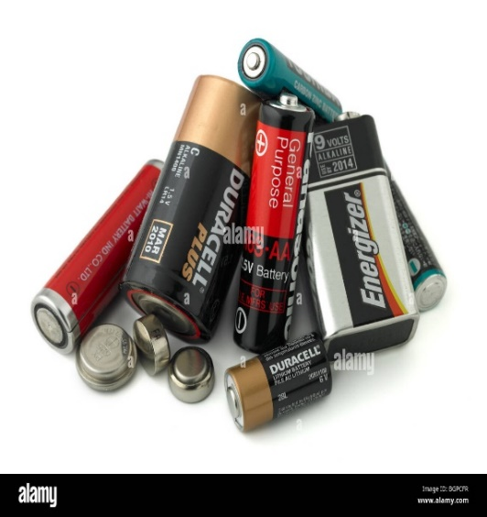
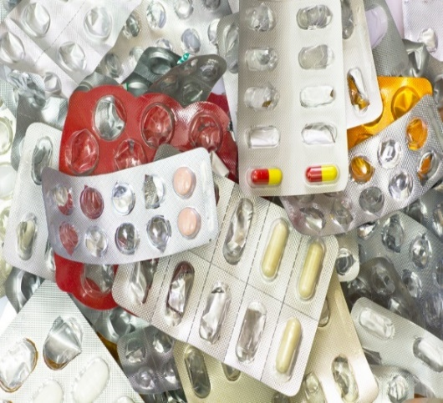
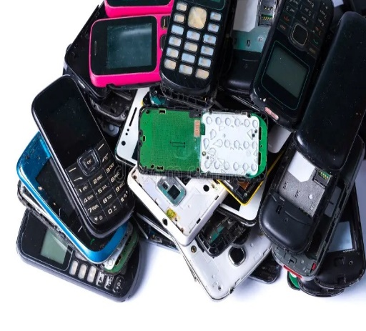
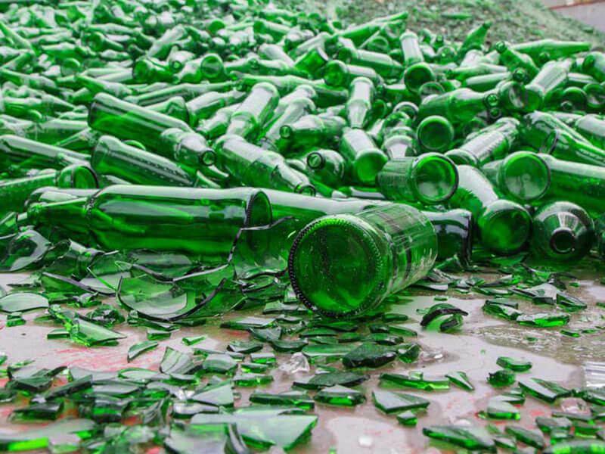
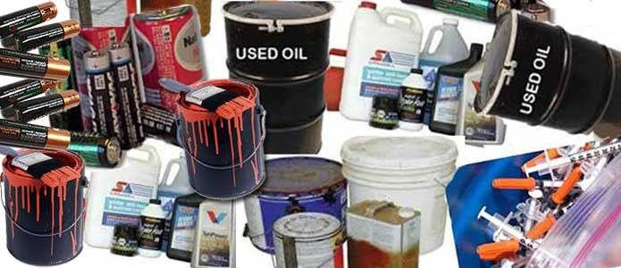
Categorization of Waste
 | Black Dustbin: This is for domestic hazardous waste, such as contaminated materials, sharps, and other potentially dangerous waste.

Slide 9
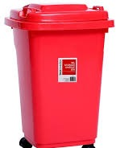
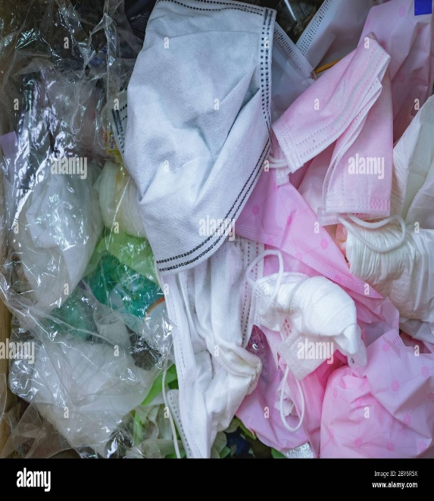
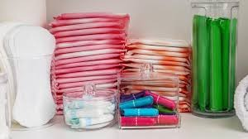
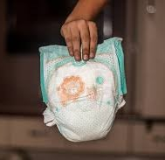
Categorization of Waste
 | Red Dustbin: This is for sanitary waste, such as Menstrual Waste, Diapers and Incontinence Pads.

Slide 10
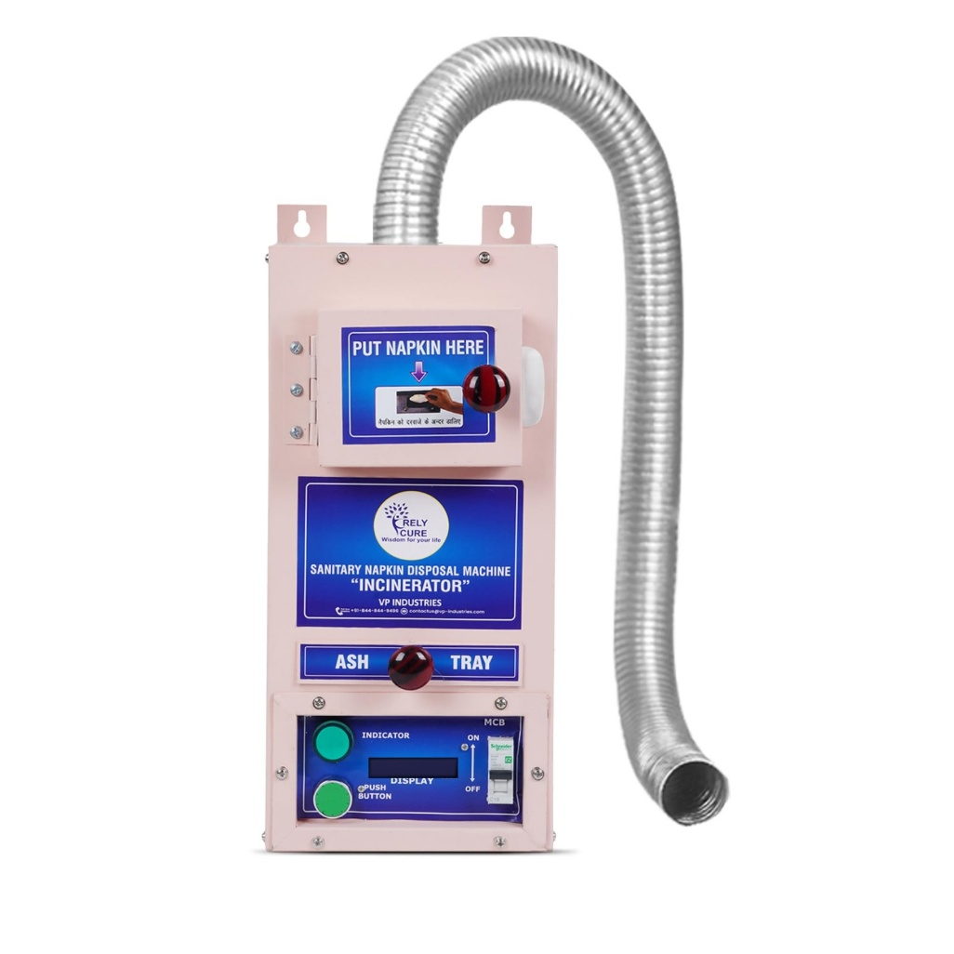
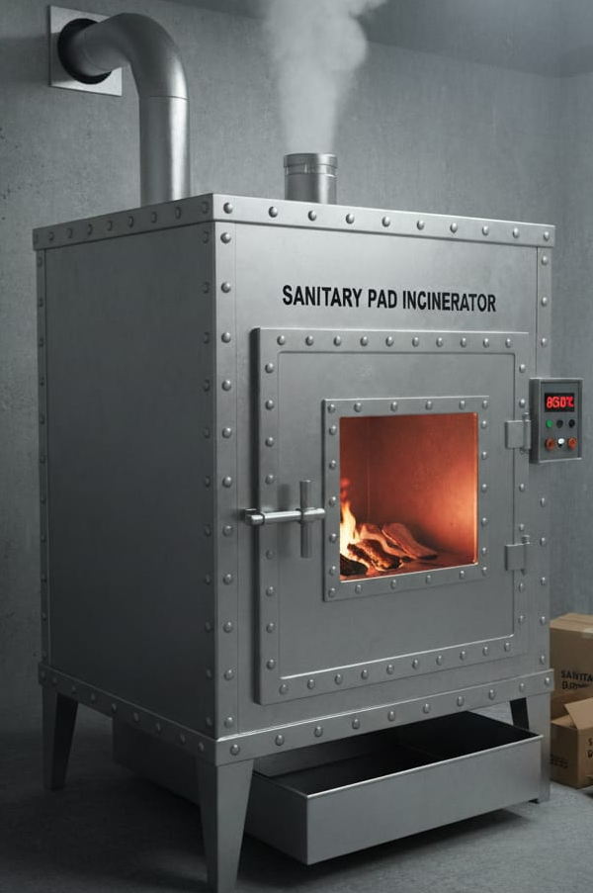
Incinerator for Sanitary Waste
Incinerator is designed for safe disposal of sanitary waste (pads, diapers, napkins). Operates at high temperatures to ensure complete combustion. Reduces volume of waste significantly, leaving sterile ash. Equipped with pollution control systems to minimize emissions. Promotes hygiene and prevents environmental contamination.

Slide 11
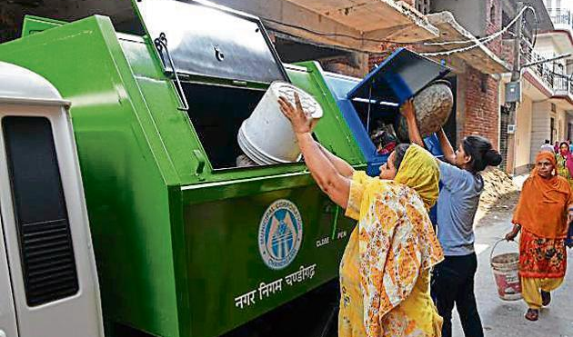
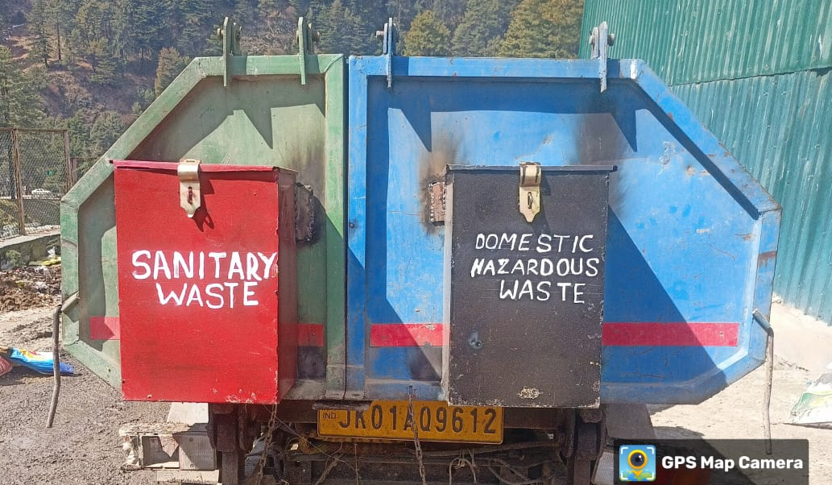
Door to Door Collection
Door-to-door waste collection ensures timely and efficient pickup of household waste directly from residents.
It promotes source segregation, making recycling and waste processing more effective.
This system helps maintain cleaner streets and healthier communities by reducing open dumping and Garbage Vulnerable Points.

Slide 12
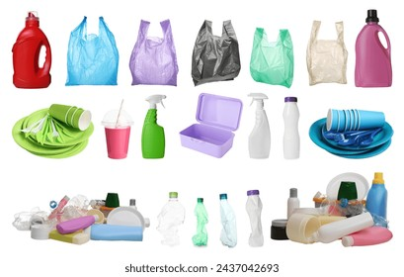
Single Use Plastic
Single-use plastic (SUP) refers to plastic products that are intended to be used only once before being discarded. These include items like plastic bags, straws, cutlery, water bottles and packaging materials. Widely used for their convenience, low cost and durability, single-use plastics have become a common part of daily life. However, their short usage life and long-lasting environmental impact have made them a major concern globally. As awareness grows about their harmful effects, many countries are taking steps to reduce or ban their use to protect the environment and public health.

Slide 13
Harmful Effects of SUP:
Human Health Risk | Single-use plastics (SUP) are harmful to human health because they can break down into micro-plastics, which enter the food chain through water, seafood and even air. These micro-plastics may carry toxic chemicals that disrupt hormones, affect immunity and increase the risk of diseases like cancer. Additionally, burning or improper disposal of SUP releases harmful gases, such as dioxins and furans, which can cause respiratory problems and other long-term health issues.
Environmental Pollution | Single-use plastics often end up in oceans, rivers and landscapes, polluting ecosystems.
Wildlife Harm | Animals can ingest or get entangled in plastic waste, leading to injury or death.
Non-Biodegradable | These plastics take hundreds of years to decompose, accumulating over time.
Toxic Chemicals | They can release harmful chemicals into soil and water, affecting health and agriculture.

Slide 14
Why Ban SUP?
Reduces Environmental Pollution | Banning it prevents plastic from littering land and water bodies.
Protects Wildlife | It helps avoid harm to animals that ingest or get entangled in plastic waste.
Cuts Down Waste | Reduces the massive volume of non-biodegradable waste in landfills.
Improves Public Health | Prevents toxic micro-plastics from entering the food chain.
Promotes Sustainable Alternatives | Encourages the use of eco-friendly and reusable materials.

Slide 15
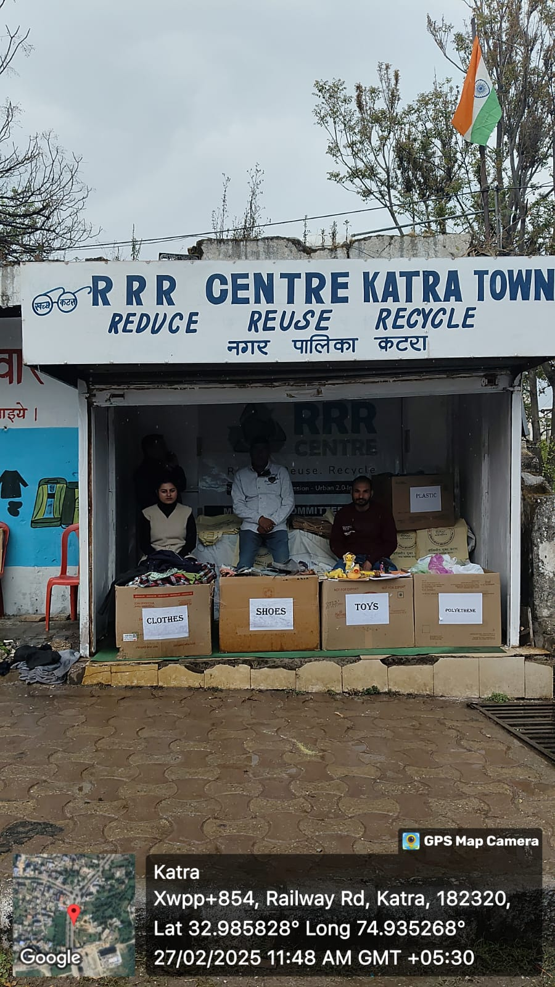
Reduce, Reuse, Recycle (3R)
RRR (Reduce, Reuse, Recycle) Centers are established to promote responsible waste management and resource recovery.
These centers serve as collection points for reusable and recyclable items from households and institutions.
Citizens are encouraged to donate old clothes, books, toys, plastic and other reusable materials.
The collected items are refurbished or recycled, reducing landfill waste and conserving resources.
RRR Centers foster community participation and support a circular economy through sustainable practices.

Slide 16
Let’s make a difference!
Combat Plastic
Adopt Four Bins, Save Nature!
🌱💚

Slide 17
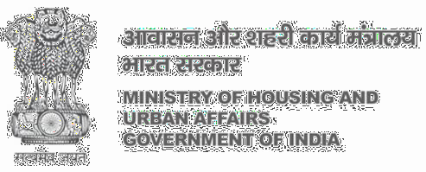
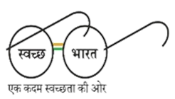

Thank You

